Slide 1
Investigating the Influences of Various Complexity of Hydrogeological Models on Pore Water Pressure Distribution Due to Seismic Wave Propagation
Name: Agustina Shinta Marginingsih
Advisor: Prof. Shih-Jung Wang
Date:2022/03/04

Slide 2
Outline
Introduction
Methodology
Preliminary Result
Conclusions
Future Work
1

Slide 3
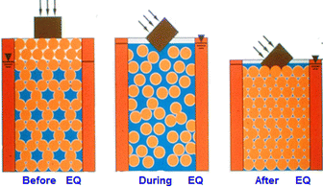
Introduction
Pore Water Pressure and Soil Liquefaction
Ground failure or loss of strength that causes otherwise solid soil to behave temporarily as a viscous liquid. The phenomenon occurs in water-saturated unconsolidated soils affected by seismic which cause ground vibrations during earthquakes.
Source: https://www.britannica.com/science/soil-liquefaction
When the pore water pressure reaches the total stress the effective stress is lost. This mechanism can be stated by the principle of effective stress, introduced by Van Terzaghi (1936):
$${\text{σ}}^{\text{′}}\text{=}\text{σ}\text{−}\text{p}$$
Full liquefaction occurs when the effective stress is equal to 0, where,
$$\text{σ}\text{=}\text{p}$$
$\text{σ}$‘: Effective stresses
$\text{σ}$: Total stress
$\text{p}\text{ :}$ Pore-water pressures
2

Slide 4
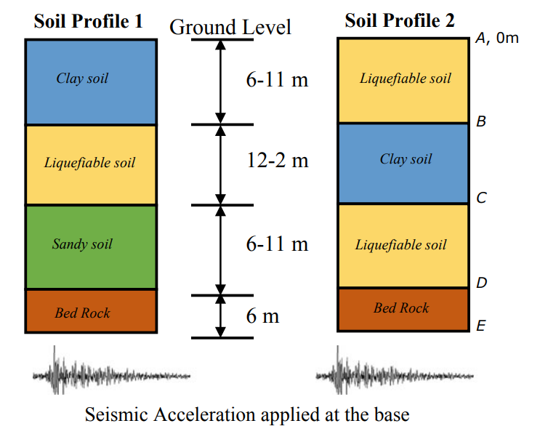
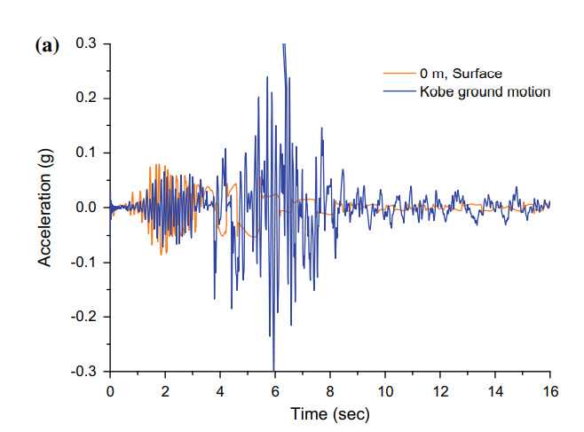
Seismic Wave Propagation in Soil Layer
The seismic waves propagate from bedrock are modified by the presence of layered soil. Recent studies have shown that the presence of a liquefiable soil layer can significantly reduce inertial load liquefaction of soil layer prevents the transmission of seismic waves (mainly shear waves) acting as shield protecting the above layers (base isolation effect) (Huded et al. 2020).
Example 1:
Example 2:
(Huded et al, 2020)
(Taiebat et al, 2010)
3

Slide 5
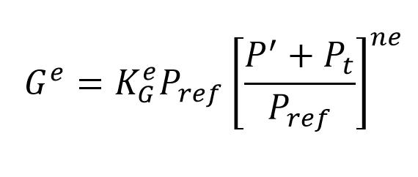
UBC-Sand Model
The UBC-SAND model is a simple elastoplastic stress/strain model for simulating the liquefaction phenomenon of sand
with a relative density less than 80%.
Elastic Response
Assumed to be isotropic and specified by elastic shear modulus ($G^{e}$) and bulk modulus ($B^{e}$):
Where: $G^{e}$ = Elastic shear modulus
$K_{G}^{e}$ = Elastic shear modulus number
$K_{B}^{e}$ = Elastic bulk modulus number
$ne$ = Exponent variable that relates the elastic shear modulus to the mean effective stress (elastic shear modulus index)
$P_{ref}$ = Reference pressure (atmospheric pressure)
$P^{′}$ = Effective confining pressure
$P_{t}$ = Maximum shear stress
4

Slide 6
UBC-Sand Model
Plastic Response
The behavior is defined by three types of yield function:
Shear failure
Volumetric Compression
Pressure cut-off
Where:
$G^{P}$ = Plastic shear modulus
$τ$ = Current shear stress
$τ_{f}$ = Failure shear stress
$R_{f}$ = Failure ratio
5

Slide 7
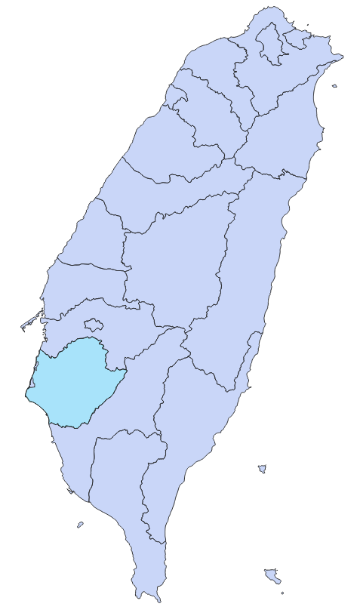
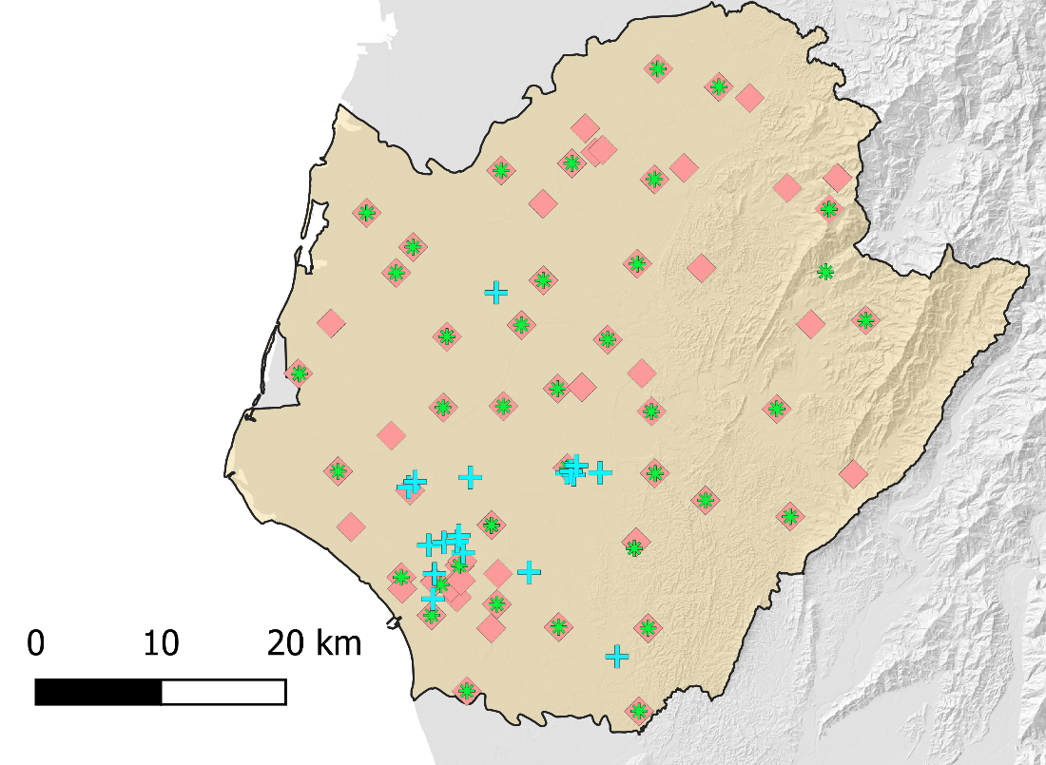
Study Area
Tainan City, Taiwan
Liquefaction occurs during :
JiaSian Earthquake ($M_{L}=\text{6.4)}$
on 4th March 2010 ( )
Meinong Earthquake ($M_{L}$= $6.6$)
on 6th February 2016 ( )
Liquefaction Point
Depth Acceleration Point
Surface Acceleration Point
6

Slide 8
Objectives
Identify the wave propagation in various hydrogeological models
Asses the dynamic distribution of displacement and pore water pressure
Discuss the liquefaction events based on the assessment result

Slide 9
Methodology
Flow Chart:
Task 1:
Task 2:
Synthetic Model
Real Case Model
Study area: Hsin-Hwa, Tainan City, Taiwan
Homogeneous medium
Perfect layer system
Pinch-out aquifer system
Hydrogeological layer system
Hydrogeological heterogeneous system
Boundary condition and parameter setting
Dynamic displacement and pore water pressure simulation
Asses the acceleration behavior and the distribution of displacement and pore water pressure
Comparison of the acceleration, displacement and pore water pressure between synthetic and real case model
Assess the soil liquefaction events

Slide 10
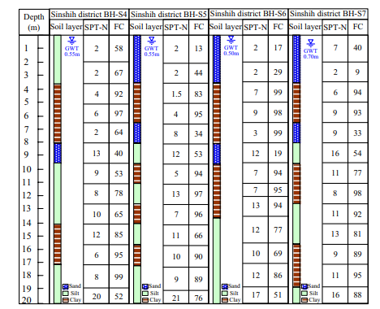
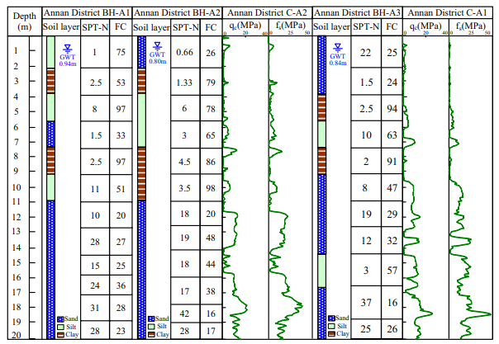
Model Set up
Simplified Synthetic
Hydrogeological Model
Soil Parameter
Boundary condition
Saturated Medium
Scenario 1. Homogeneous medium
Scenario 2. Perfect layer system
Dimension:
Depth: 30 m
Width : 80 m
(Lu et al. 2020)
Sand
Clay
Scenario 3. Pinch-out aquifer system

Slide 11
Model Set up
Simplified Synthetic
Hydrogeological Model
Soil Parameter
Boundary condition
Sand Layer:
Modulus of elasticity (E) | 877 kN/m²
Elastic shear modulus number ($K_{G}^{e}$) | 1,100
Elastic shear modulus index (ne) | 0.5
Plastic shear modulus number ($K_{G}^{p}$) | 310
Plastic shear modulus index (np) | 0.4
Poisson’s ratio | 0.02
Undrained Poisson’s ratio | 0.495
Unit weight ($γ_{unsat}$) | 18 kN/m³
Unit weight ($γ_{sat}$) | 20 kN/m³
Cohesion (c) | 0 kPa
Peak friction angle ($∅_{p})$ | 33.8
Constant volume friction angle ($∅_{cv})$ | 33
Earth pressure coefficient ($K_{0}$) | 1
Post liquefaction calibration | 0.6
Reference pressure ($P_{ref}$) | 100 kN/m²
Failure ratio ($R_{f}$) | 0.9
(Huded et al. 2020)

Slide 12
Model Set up
Simplified Synthetic
Hydrogeological Model
Soil Parameter
Boundary condition
Clay Layer:
Modulus of elasticity (E) | 8500 kN/m²
Poisson’s ratio | 0.2
Undrained Poisson’s ratio | 0.495
Unit weight ($γ_{unsat}$) | 16 kN/m³
Unit weight ($γ_{sat}$) | 20 kN/m³
Cohesion (c) | 10 kN/m²
Frictional angle ($∅)$ | 33.8
Dilatancy angle ($ψ)$ | 0
Earth pressure coefficient ($K_{0}$) | 1
(Huded et al. 2020)

Slide 13
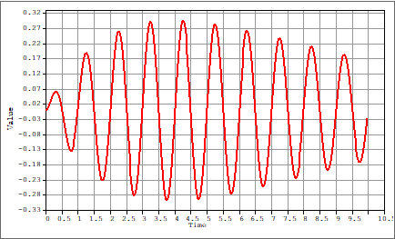
Model Set up
Simplified Synthetic
Hydrogeological Model
Soil Parameter
Input and Boundary Condition
Driving Seismic Wave
The wave simulation will use the sinusoidal (a max: 0.3 g) wave as input.
The sinusoidal wave will be generated horizontally at the bottom of the domain.
Surface: Free to move in x and y directions (Traction-free boundary condition)
Sides:
Absorbent boundary to eliminate reflection wave at the sides
Bottom: Fixed (Roller Boundary)

Slide 14
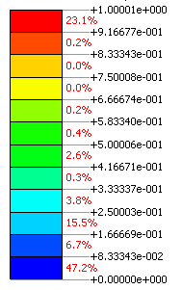
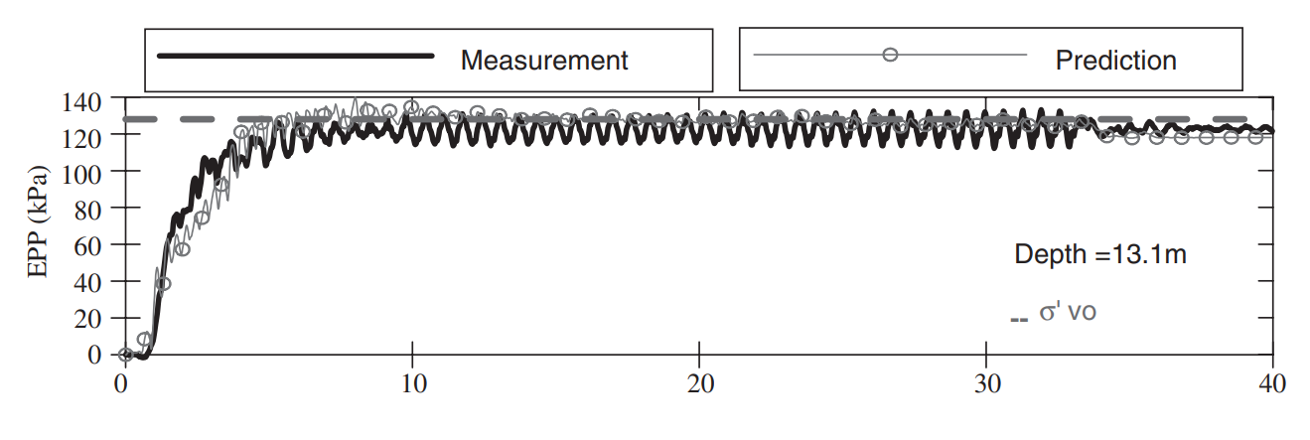
Preliminary Result
Homogeneous System
Perfect Layer System
Pinch-Out Aquifer System
Pore water pressure distribution
Excess Pore Water Pressure Ratio
Acceleration Direction
Time (sec)
(Byrne et al. 2003)

Slide 15
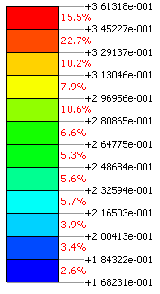
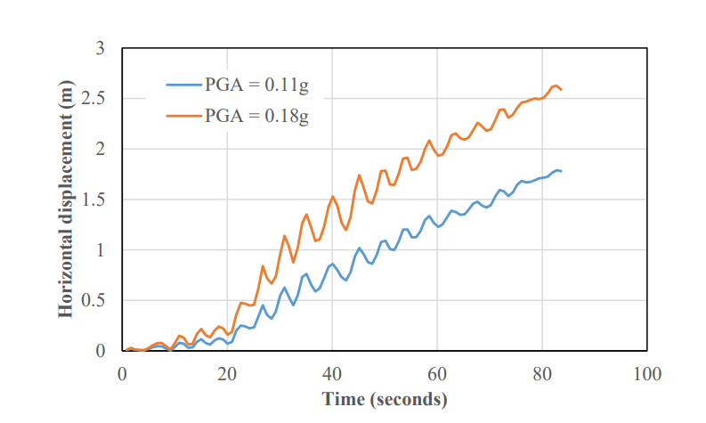
Preliminary Result
Homogeneous System
Perfect Layer System
Pinch-Out Aquifer System
Horizontal Displacement
Displacement(m)
Time (sec)
Acceleration Direction
(Bowen et al. 2015)

Slide 16
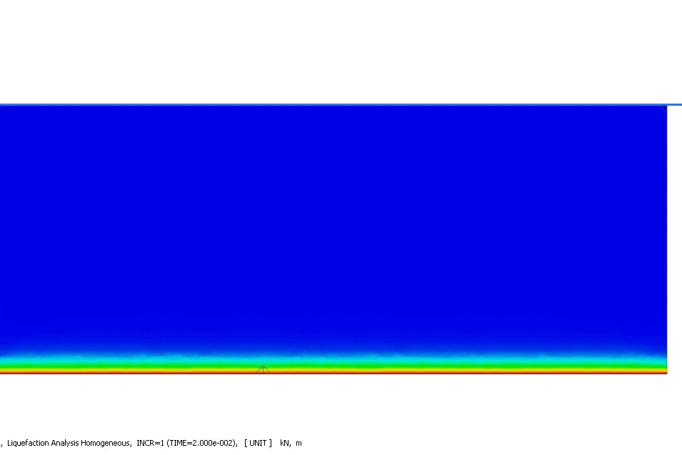
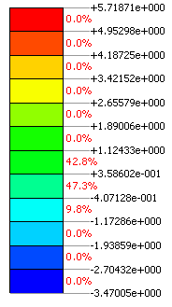
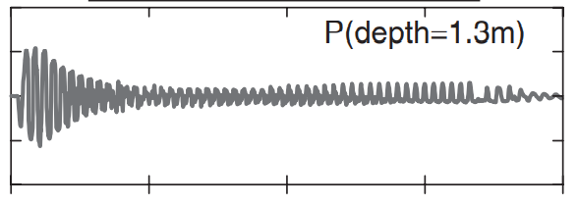
Preliminary Result
Homogeneous System
Perfect Layer System
Pinch-Out Aquifer System
Acceleration
Acceleration (m/sec² )
4
2
Acceleration Direction
0
-2
-4
10
20
30
(Byrne et al. 2003)
Time (sec)

Slide 17
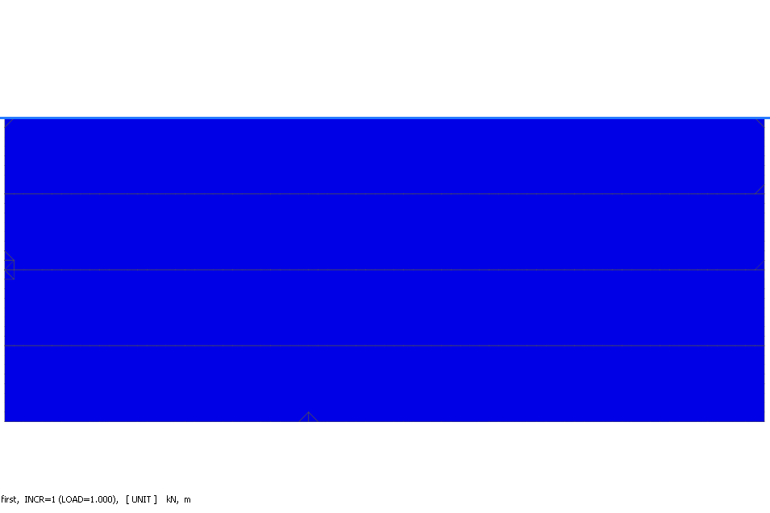
Preliminary Result
Perfect Layer System
Pinch-Out Aquifer System
Homogeneous System
Pore water pressure distribution
Excess Pore Water Pressure Ratio
Acceleration Direction
(Byrne et al. 2003)
Time (sec)

Slide 18
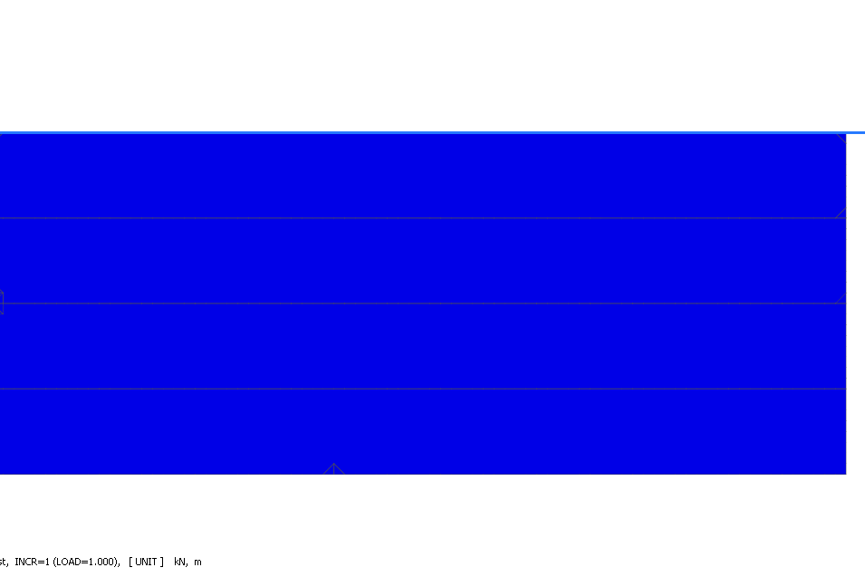
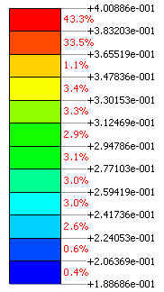
Preliminary Result
Perfect Layer System
Pinch-Out Aquifer System
Homogeneous System
Horizontal Displacement
Displacement(m)
Time (sec)
Acceleration Direction
(Bowen et al. 2015)

Slide 19
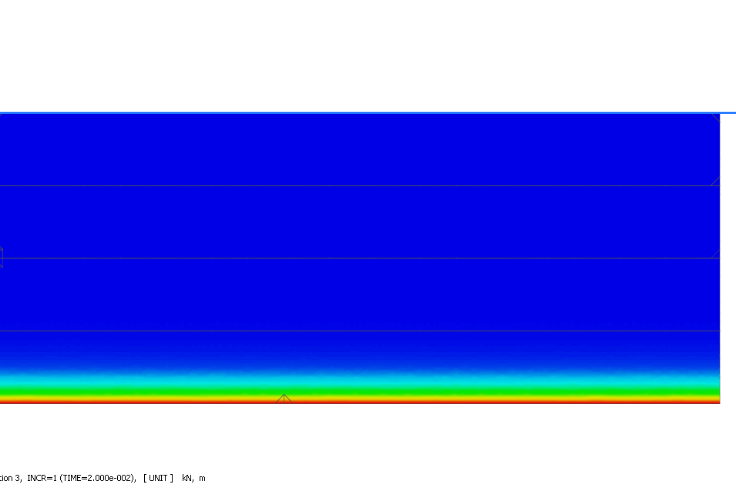
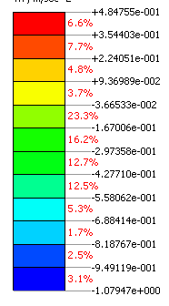
Preliminary Result
Perfect Layer System
Pinch-Out Aquifer System
Homogeneous System
Acceleration
Acceleration (m/sec² )
4
2
Acceleration Direction
0
-2
-4
10
20
30
Time (sec)
(Byrne et al. 2003)

Slide 20
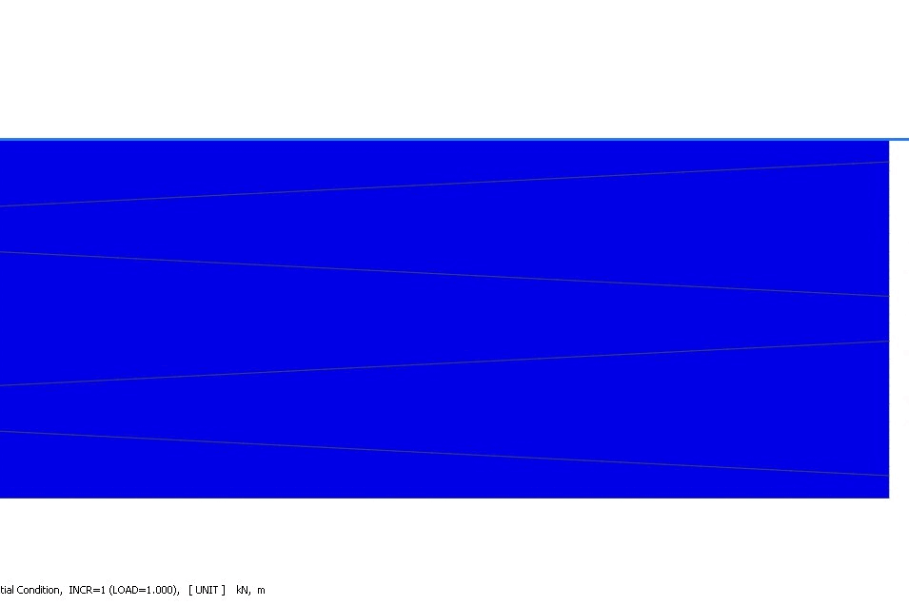
Preliminary Result
Perfect Layer System
Pinch-Out Aquifer System
Homogeneous System
Pore water pressure distribution
Excess Pore Water Pressure Ratio
Acceleration Direction
Why the bottom sandy layer not liquefy?
Time (sec)
(Byrne et al. 2003)

Slide 21
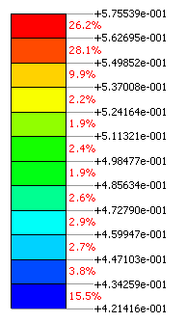
Preliminary Result
Perfect Layer System
Pinch-Out Aquifer System
Homogeneous System
Horizontal Displacement
Top Left
Top Right
(Bowen et al. 2015)
Displacement(m)
Bottom Left
Bottom Right
Acceleration Direction
Time (sec)

Slide 22
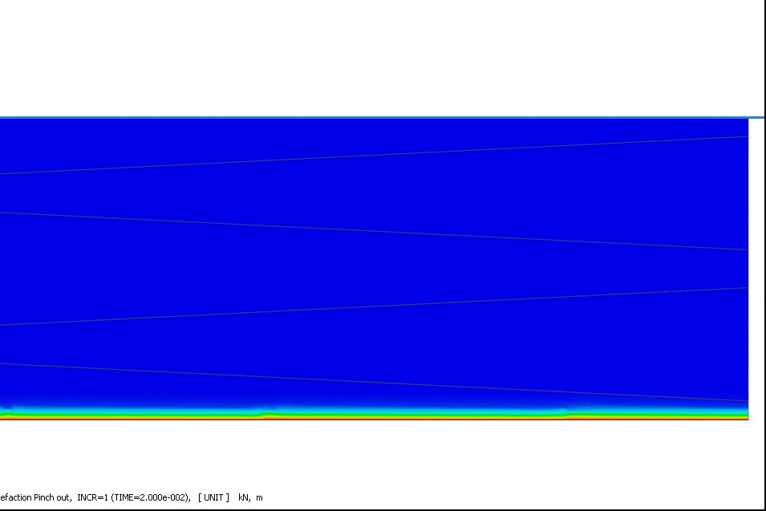
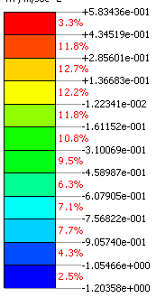
Preliminary Result
Perfect Layer System
Pinch-Out Aquifer System
Homogeneous System
Acceleration
Top Left
Top Right
4
2
Acceleration (m/sec² )
0
-2
Bottom Left
Bottom Right
-4
Acceleration Direction
10
20
30
(Byrne et al. 2003)
Time (sec)

Slide 23
Conclusion
The behavior of pore water pressure, acceleration, and displacement shows in the model.
Pore water pressure increase gradually and stay in the maximum value after the liquefaction occurs (Pore water pressure ratio =1).
Acceleration different in the surface.
The horizontal displacement…

Slide 24
Future work
Fixing the boundary effect
Generate the real seismic wave under the synthetic hydrogeological model
Simulate the real data

Slide 25
Unstable Computation

Slide 26
Thank You

Slide 27
The typical mechanism of response observed in different elements during the shaking:
Contractive Response
The early stages of loading in a cycle : the excess pore pressure increase with the decrease of vertical effective stress and stiffness.
Dilative Response
As loading continues to larger stress ratios : the excess pore pressure decreases and the vertical effective stress and the soil stiffness increase.
Contractive Response
Upon and after reversal of shear stress increment, the excess pore pressure increase and vertical effective stress and soil stiffness decrease.
Dilative Response
As the absolute value of the stress ratio exceeds a certain level in the reverse loading. The excess pore pressure decreases and the vertical effective stress and the soil stiffness increase.
Contractive Response
The final stress-ratio increment reversal in the loading cycle. The excess pore pressure increase and vertical effective stress and soil stiffness decrease.
For looser samples (higher confining pressure) the contractive response is more pronounced.
For denser samples (lower confining pressure) the dilative response is more pronounced.

Slide 28
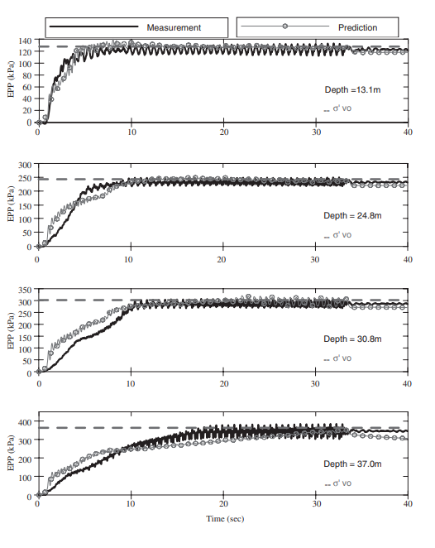
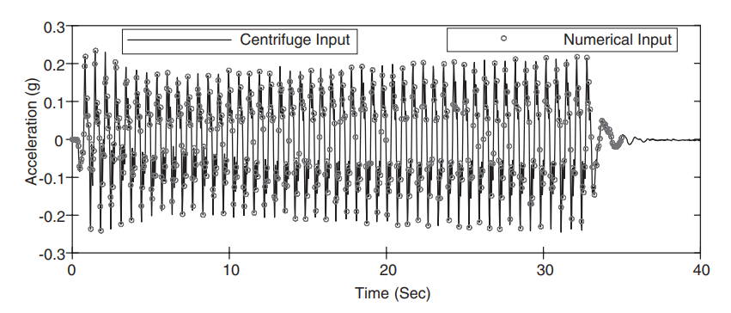

Slide 29
UBC-Sand Model
Where:
$∆sin∅_{m}$= the increment of friction angle
$G^{P}$ = Plastic shear modulus
$P^{′}$ = Current pressure
$∆κ_{s}$ = the increment of plastic shear strain
$K_{G}^{p}$ = Plastic shear modulus number
$sin∅_{m}$ = Current friction angle
$sin∅_{p }$ = Peak friction angle
$R_{f}$ = Failure ratio
$ε$ = Strain
$f_{2}$ = Post liquefaction factor
$p$ = Pressure
$K_{B}^{p}$ = Plastic bulk modulus number
$mp$ = Plastic bulk modulus exponent
$P_{cut}$ = Pressure cut-off
Plastic Response
Shear failure
Volumetric Compression
Pressure cut-off
5

Slide 30
Expected Result
Determine the behavior of dynamic distribution displacement and pore water pressure in different scenarios
In first year, the simplified synthetic hydrogeological simulations can be generated for seismic wave propagation in the poroelastic medium.
In the second year, generate real-case wave propagation simulations use two hydrogeological models of the layer system and heterogeneous system.
After compare the synthetical and the real case model we can asses the soil liquefaction potential.

Slide 31
