Slide 1
Assessment of Aquifer Storage and Recover Feasibility Using Numerical Modeling and Geospatial Analysis : Application in Louisiana
Olivia LaHaye, Emad H. Habib, Hamid Vahdat-Aboueshagh,Frank T.C. Tsai,David Borrok,2021
JAWRA Journal of the American Water Resources Association, 57(3), 505-526.
Student: Bo-Feng Lee
Advisor: Prof. Jui-Sheng Chen
Co-Advisor: Prof. Ching-Ping Liang
Date: 2022/05/27
1

Slide 2
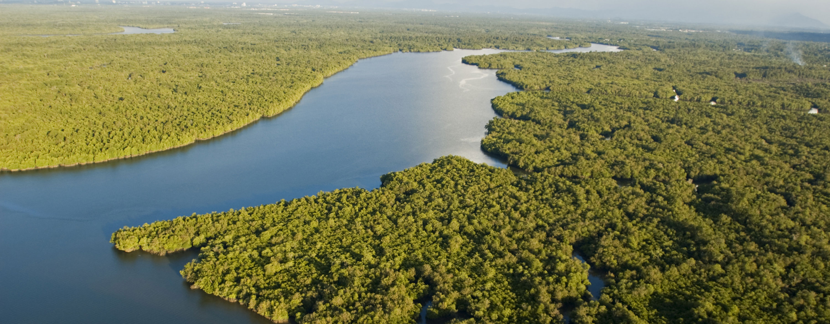
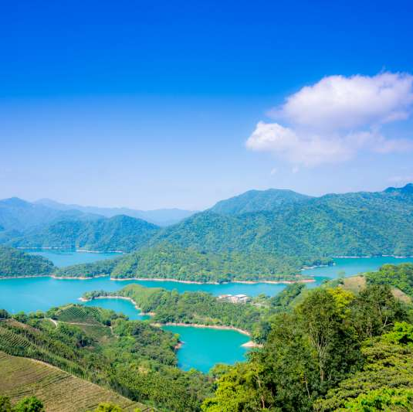
Outlines
1.Introduction
2.Method and materials
3.Results and discussion
4. Conclusions
2

Slide 3
1.Introduction
3

Slide 4
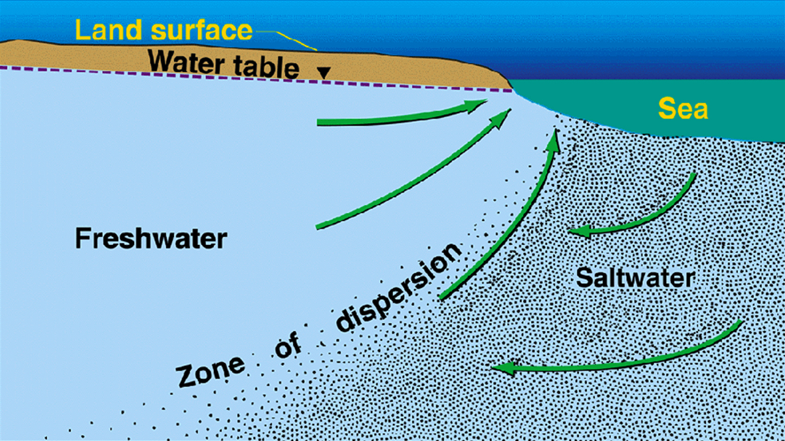
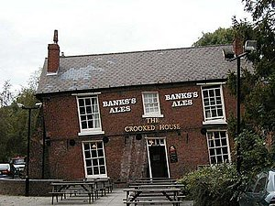
Stresses on water resources
Stresses on water resources are often attribute to increased demand, longer droughts , encroachment of saline waters or a combination of these factors (Zektser et al. 2005; Heywood et al. 2014; Borrok et al. 2018).
Overpumping in coastal regions has led to consequences such as subsidence(e.g., Budhu and Adiyaman 2010; Dokka 2011; Jones et al. 2016) and saltwater intrusion often before there are any signs of water deficit (Agarwal et al. 2013; Ross and Hasnain 2018).
encroachment of saline waters
subsidence
4

Slide 5
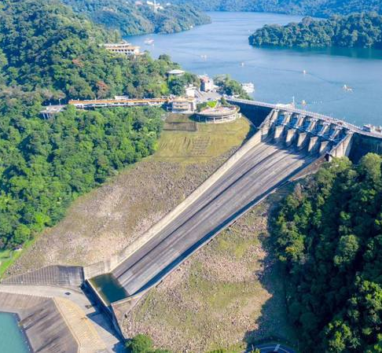
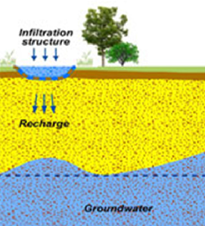
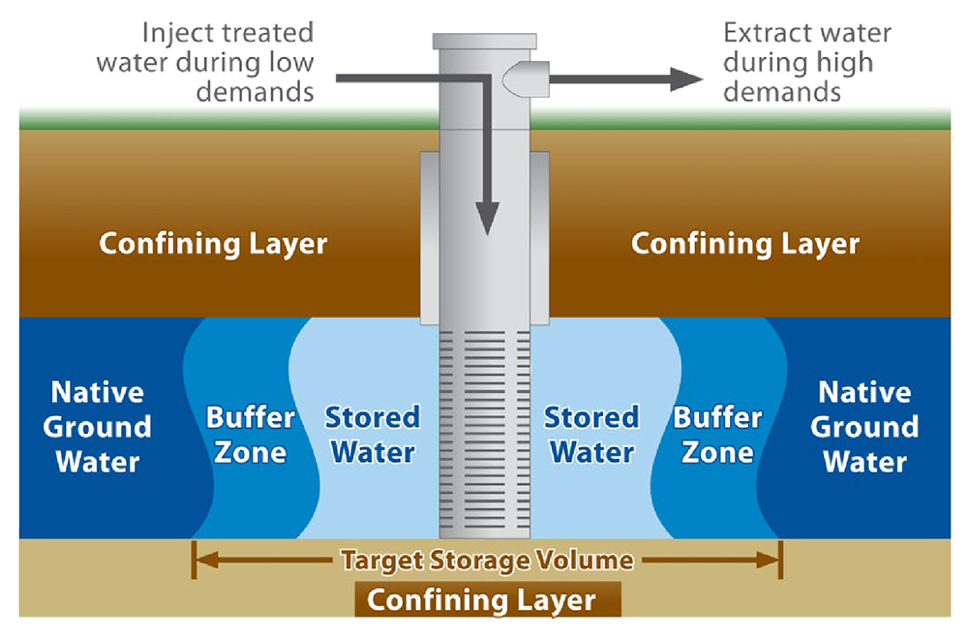
Water storage method
surface reservoir
Water storage method
infiltration basins
managed aquifer recharge (MAR)
aquifer storage and recovery (ASR)
5

Slide 6
Surface reservoir
surface reservoir
Water storage method
infiltration basins
(MAR)
Surface reservoir is the most common water storage facility.
However, surface reservoirs is sometimes problematic due to concerns of land acquisition, protection from contaminants, and preventing significant evaporation or seepage losses (CDM Federal Programs Corporation 2017).
Moreover, the relatively flat-lying land in coastal regions presents a challenge to the construction of reservoirs.
(ASR)
6

Slide 7
Infiltration basins
surface reservoir
Water storage method
infiltration basins
(MAR)
(ASR)
Infiltration basins are used to increase natural recharge for replenishing the aquifer
But these basins are only efficient for highly permeable or unconfined aquifers and require ample land space and maintenance (Dillon et al., 2009).
7

Slide 8
Aquifer storage and recovery (ASR)
surface reservoir
Water storage method
infiltration basins
(MAR)
ASR is based on collecting excess water from surface sources and injecting it into a subsurface aquifer to be stored for anticipated use (CDM Federal Programs Corporation 2017).
This method is versatile since it can be applied most anywhere, with all types of aquifers, and requires just little land space. (Kelly et al., 2013; Webb 2015).
mitigate demand the stress of water
protect the aquifer against increasing saltwater intrusion
Subsidence
(ASR)
8

Slide 9
Objective
surface reservoir
Water storage method
infiltration basins
(MAR)
(ASR)
This study is heavily focused on the recharge component of ASR due to the current threat of coastal land loss which is contributed by subsidence and saltwater intrusion due to overdrafting.
9

Slide 10
2.Method and materials
10

Slide 11
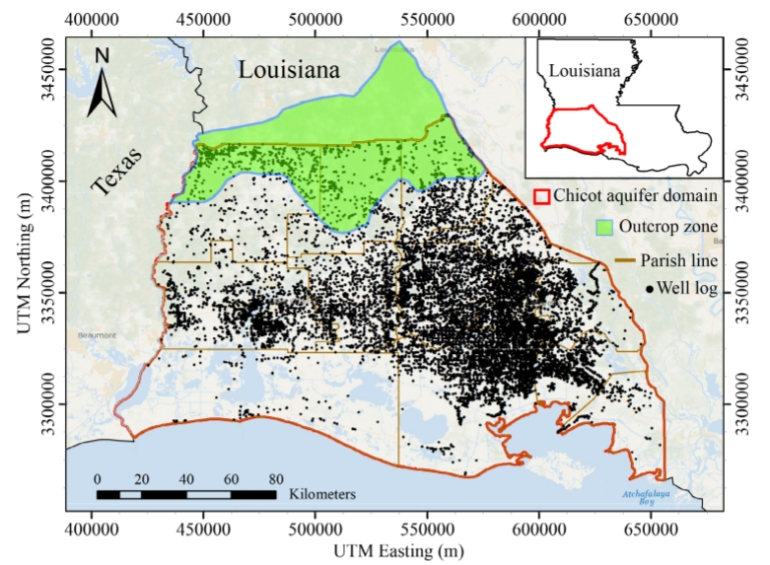
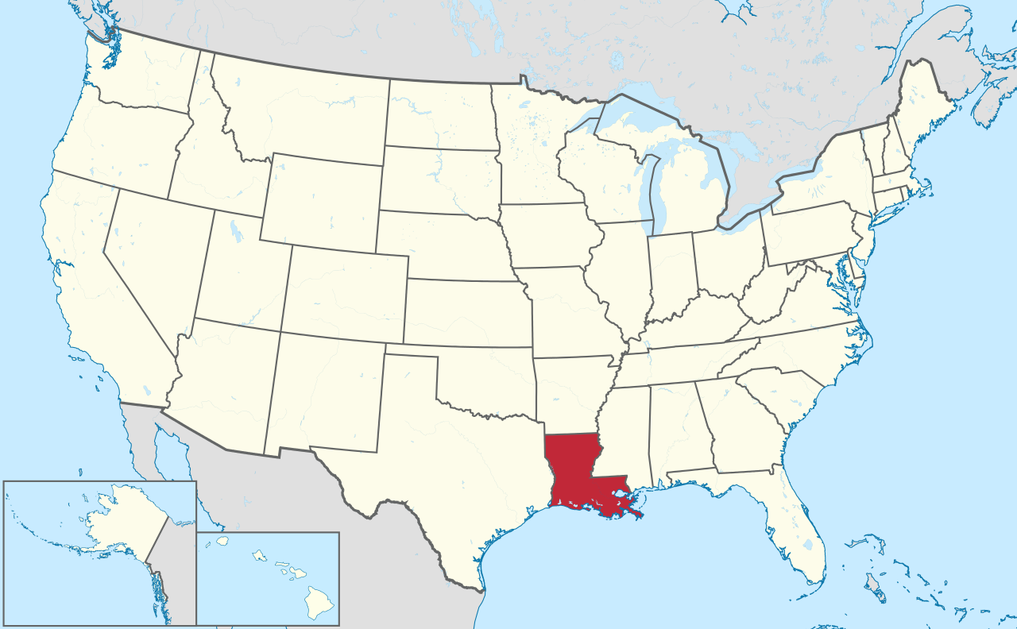
Study area
Louisiana , where is a state in the Deep South and South Central regions of the United States.
It is a coastal state with high population density.Which means its hard to conduct a surface reservoir and infiltration basins.
11

Slide 12
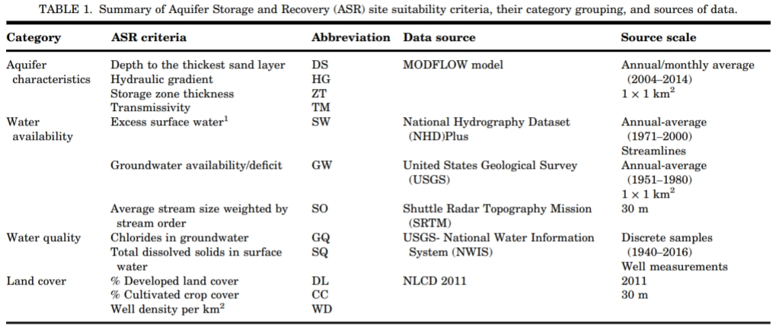
Parameter
12

Slide 13
Parameter processing
cumulative distribution function (CDF)
[Turn the unit from meter to (%)]
13

Slide 14
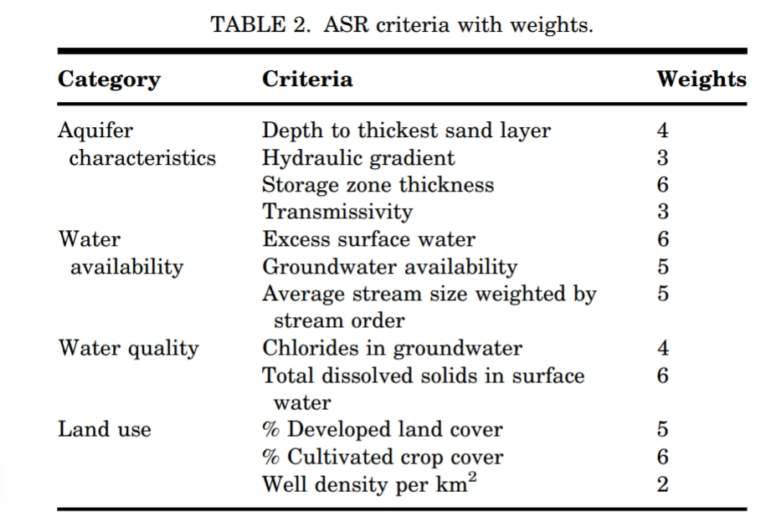
Weights determine
Decide by discussion with expert
Higher weight
Higher weight
Higher weight
Higher weight
Lower weight
14

Slide 15
3.Results and discussion
15

Slide 16
Aquifer characteristics and water availability score
Tier I included criteria from aquifer characteristics and water availability(do not consider HG and TM at first), and the results show unsuitable watersheds mostly similar to those based on the storage ZT criteria. However, suitable watersheds are very limited by the inclusion of the surface water availability criteria.
16

Slide 17
Aquifer characteristics and water availability score
Tier II introduced two more aquifer characteristics, HG and TM, which mainly represent the migration potential of the stored water. For the purpose of ASR in this region, these aquifer features do not carry much weight in the overall suitability because the stored water is not intended to be restricted for use by only one entity. Therefore, they were given low weight factors and thus did not cause much of a change to the overall index.
17

Slide 18
Water quality score
Tier III introduced the water quality for surface and groundwater.Tier III results in more unsuitable watersheds around Calcasieu Lake and Vermillion Bay as a result of the surface water salinity, which is a new multiplier in this tier. At this point, the groundwater salinity has become insignificant in comparison to other criteria that control the unsuitable watersheds.
18

Slide 19
Land cover score
Tier IV introduced cultivated crop cover and developed land. These land cover classifications are important for locating watersheds with high irrigation activity and also for ensuring a suitable area will have sufficient power and access roads.
north of the Calcasieu Lake
19

Slide 20
4. Conclusions
20

Slide 21
4.Conclusions
ASR represents a potentially effective water management approach in coastal regions to address the overuse of groundwater resources, reduce land subsidence, and provide a barrier for saltwater intrusion.Also , it’s a viable water management strategy that can alleviate stresses on groundwater systems .
As the ideal conditions for ASR suitability are not universally defined and can be highly region dependent. This SI methodology can be applied to any region and easily adapted for use in a variety of water management scenarios in addition to ASR feasibility.
21

Slide 22
Thanks for the attention ☺
22

Slide 23
解釋變數 | 分類 | 名稱 | 描述 | 資料來源
 | 污染源驅動力 | 縣市人口數(人) | 全台縣市各區之人口數,面積,人口密度 | 內政部戶政司
 |  | 縣市面積(平方公里)
 |  | 縣市人口密度(人/平方公里)
 |  | 縣市豬養殖頭數(頭) | 全台縣市各區各家畜之殖頭數,宰頭數,養殖面積 | 行政院農委會
 |  | 縣市豬屠宰頭數(頭)
 |  | 縣市牛屠宰頭數(頭)
 |  | 縣市羊屠宰頭數(頭)
 |  | 縣市豬養殖面積(公頃)
 |  | 縣市牛養殖面積(公頃)
 |  | 縣市羊養殖面積(公頃)
 |  | 垃圾掩埋場距離井之位置(km) | 垃圾掩埋場距離井之位置及處理量,共109站 | 行政院環保署
 |  | 垃圾掩埋場處理量(公噸)
 |  | aqi | 參考行政院環保署空氣品質指標以及空氣汙染指標監測之so2coo3pm10pm2.5no2
 |  | so2
 |  | co
 |  | o3
 |  | pm10
 |  | pm2.5
 |  | no2
 |  | nox
 |  | 農業利用土地(%) | 土地利用分級分類109~110年,觀測井周圍的土地利用百分比 | 內政部國土測繪中心
 |  | 森林利用土地(%)
 |  | 交通利用土地(%)
 |  | 水利利用土地(%)
 |  | 建築利用土地(%)
 |  | 公共利用土地(%)
 |  | 遊憩利用土地(%)
 |  | 礦鹽利用土地(%)
 |  | 其他利用土地(%)
 | 水文地質特性 | 水文地質礫石組成(%) | 地質組成百分比 內政部國土測繪中心,共收錄鑽孔資料：509孔 經濟部中央地質調查所(截至111年04月30日止),共收錄鑽孔資料：53,085孔 | 內政部國土測繪中心 及 經濟部中央地質調查所
 |  | 水文地質砂土組成(%)
 |  | 水文地質坋土組成(%)
 |  | 水文地質黏土組成(%)
 | 水質參數 | 河川測站距離井之位置(km) | 附近河川觀測站之水質參數,共3712站 | 行政院環保署
 |  | 河川測站污染指數
 |  | 河川測站氣溫(℃)
 |  | 河川測站水溫(℃)
 |  | 河川測站酸鹼值
 |  | 河川測站導電度(μmho/cm25℃)
 |  | 河川測站溶氧(電極法)(mg/L)
 |  | 河川測站溶氧飽和度(%)
 |  | 河川測站生化需氧量(mg/L)
 |  | 河川測站化學需氧量(mg/L)
 |  | 河川測站懸浮固體(mg/L)
 |  | 河川測站大腸桿菌群(CFU/100mL)
 |  | 河川測站氨氮(mg/L)
 |  | 河川測站氯鹽(mg/L)
 |  | 河川測站總磷(mg/L)
 |  | 河川測站總有機碳(mg/L)
 |  | 河川測站亞硝酸鹽氮(mg/L)
 |  | 河川測站鎘(mg/L)
 |  | 河川測站鉛(mg/L)
 |  | 河川測站六價鉻(mg/L)
 |  | 河川測站砷(mg/L)
 |  | 河川測站汞(mg/L)
 |  | 河川測站銅(mg/L)
 |  | 河川測站鋅(mg/L)
 |  | 河川測站錳(mg/L)
 |  | 河川測站銀(mg/L)
 |  | 河川測站鎳(mg/L)
 |  | 靜水位(m) | 觀測井附近之水位井之抽水試驗數據,共計808口 | 經濟部水利署
 |  | 抽水量(cmh)
 |  | 含水層位置(m)
 |  | 單位洩降出水量 Q/s (cmh/m)
 |  | 透水係數K (m/min)
 |  | 導水係數T (m2/min)
 |  | 年平均降雨量(mm)
 |  | 水面至井口深度(m) | 監測井測得之水質數據,共計412口 | 行政院環保署
 |  | 水溫(℃)
 |  | 導電度(μmho/cm25℃)
 |  | 酸鹼值
 |  | 河川測站溶氧(電極法)(mg/L)
 |  | 氧化還原電位
 |  | 總硬度
 |  | 總溶解固體物(mg/L)
 |  | 氯鹽(mg/L)
 |  | 氨氮(mg/L)
 |  | 硫酸鹽(mg/L)
 |  | 總有機碳
 |  | 砷(mg/L)
 |  | 鎘(mg/L)
 |  | 鉻(mg/L)
 |  | 銅(mg/L)
 |  | 鉛(mg/L)
 |  | 鋅(mg/L)
 |  | 鐵(mg/L)
 |  | 錳(mg/L)
 |  | 汞(mg/L)
 |  | 鎳(mg/L)
 |  | 總酚(mg/L)
 |  | 氟鹽(mg/L)
 |  | 鈉(mg/L)
 |  | 鉀(mg/L)
 |  | 鈣(mg/L)
 |  | 鎂(mg/L)
 |  | 總鹼度
 |  | 大腸桿菌群 (CFU/100 mL) | 觀測井測得之水質數據,共計320口 | 經濟部水利署
 |  | 氯鹽 (mg/L)
 |  | 硫酸鹽(mg/L)
 |  | 氨氮 (mg/L)
 |  | 硫化物 (mg/L)
 |  | 總有機碳 (mg/L)
 |  | 銅 (mg/L)
 |  | 鎘 (mg/L)
 |  | 鉛 (mg/L)
 |  | 鋅 (mg/L)
 |  | 鉻 (mg/L)
 |  | 鎳 (mg/L)
 |  | 鐵 (mg/L)
 |  | 錳 (mg/L)
 |  | 鈣 (mg/L)
 |  | 鎂 (mg/L)
 |  | 鈉 (mg/L)
 |  | 鉀 (mg/L)
 |  | 碳酸氫根 (mg/L)
 |  | 碳酸根 (mg/L)
 |  | 砷 (mg/L)
 |  | 汞 (mg/L)
 |  | 總溶解固體 (mg/L)
 |  | 硬度 (as CaCO₃ mg/L)
預測變數 |  | 硝酸鹽氮 | 監測井硝酸鹽氮濃度,共計732口 | 行政院環保署
 |  |  |  | 經濟部水利署
解釋變數 | 分類 | 名稱 | 描述 | 資料來源
 | 污染源驅動力 | 縣市人口數(人) | 全台縣市各區之人口數,面積,人口密度 | 內政部戶政司
 |  | 縣市面積(平方公里)
 |  | 縣市人口密度(人/平方公里)
 |  | 縣市豬養殖頭數(頭) | 全台縣市各區各家畜之殖頭數,宰頭數,養殖面積 | 行政院農委會
 |  | 縣市豬屠宰頭數(頭)
 |  | 縣市牛屠宰頭數(頭)
 |  | 縣市羊屠宰頭數(頭)
 |  | 縣市豬養殖面積(公頃)
 |  | 縣市牛養殖面積(公頃)
 |  | 縣市羊養殖面積(公頃)
 |  | 垃圾掩埋場距離井之位置(km) | 垃圾掩埋場距離井之位置及處理量,共109站 | 行政院環保署
 |  | 垃圾掩埋場處理量(公噸)
 |  | aqi | 參考行政院環保署空氣品質指標以及空氣汙染指標監測之so2coo3pm10pm2.5no2
 |  | so2
 |  | co
 |  | o3
 |  | pm10
 |  | pm2.5
 |  | no2
 |  | nox
 |  | 農業利用土地(%) | 土地利用分級分類109~110年,觀測井周圍的土地利用百分比 | 內政部國土測繪中心
 |  | 森林利用土地(%)
 |  | 交通利用土地(%)
 |  | 水利利用土地(%)
 |  | 建築利用土地(%)
 |  | 公共利用土地(%)
 |  | 遊憩利用土地(%)
 |  | 礦鹽利用土地(%)
 |  | 其他利用土地(%)
 | 水文地質特性 | 水文地質礫石組成(%) | 地質組成百分比 內政部國土測繪中心,共收錄鑽孔資料：509孔 經濟部中央地質調查所(截至111年04月30日止),共收錄鑽孔資料：53,085孔 | 內政部國土測繪中心 及 經濟部中央地質調查所
 |  | 水文地質砂土組成(%)
 |  | 水文地質坋土組成(%)
 |  | 水文地質黏土組成(%)
 | 水質參數 | 河川測站距離井之位置(km) | 附近河川觀測站之水質參數,共3712站 | 行政院環保署
 |  | 河川測站污染指數
 |  | 河川測站氣溫(℃)
 |  | 河川測站水溫(℃)
 |  | 河川測站酸鹼值
 |  | 河川測站導電度(μmho/cm25℃)
 |  | 河川測站溶氧(電極法)(mg/L)
 |  | 河川測站溶氧飽和度(%)
 |  | 河川測站生化需氧量(mg/L)
 |  | 河川測站化學需氧量(mg/L)
 |  | 河川測站懸浮固體(mg/L)
 |  | 河川測站大腸桿菌群(CFU/100mL)
 |  | 河川測站氨氮(mg/L)
 |  | 河川測站氯鹽(mg/L)
 |  | 河川測站總磷(mg/L)
 |  | 河川測站總有機碳(mg/L)
 |  | 河川測站亞硝酸鹽氮(mg/L)
 |  | 河川測站鎘(mg/L)
 |  | 河川測站鉛(mg/L)
 |  | 河川測站六價鉻(mg/L)
 |  | 河川測站砷(mg/L)
 |  | 河川測站汞(mg/L)
 |  | 河川測站銅(mg/L)
 |  | 河川測站鋅(mg/L)
 |  | 河川測站錳(mg/L)
 |  | 河川測站銀(mg/L)
 |  | 河川測站鎳(mg/L)
 |  | 靜水位(m) | 觀測井附近之水位井之抽水試驗數據,共計808口 | 經濟部水利署
 |  | 抽水量(cmh)
 |  | 含水層位置(m)
 |  | 單位洩降出水量 Q/s (cmh/m)
 |  | 透水係數K (m/min)
 |  | 導水係數T (m2/min)
 |  | 年平均降雨量(mm)
 |  | 水面至井口深度(m) | 監測井測得之水質數據,共計412口 | 行政院環保署
 |  | 水溫(℃)
 |  | 導電度(μmho/cm25℃)
 |  | 酸鹼值
 |  | 河川測站溶氧(電極法)(mg/L)
 |  | 氧化還原電位
 |  | 總硬度
 |  | 總溶解固體物(mg/L)
 |  | 氯鹽(mg/L)
 |  | 氨氮(mg/L)
 |  | 硫酸鹽(mg/L)
 |  | 總有機碳
 |  | 砷(mg/L)
 |  | 鎘(mg/L)
 |  | 鉻(mg/L)
 |  | 銅(mg/L)
 |  | 鉛(mg/L)
 |  | 鋅(mg/L)
 |  | 鐵(mg/L)
 |  | 錳(mg/L)
 |  | 汞(mg/L)
 |  | 鎳(mg/L)
 |  | 總酚(mg/L)
 |  | 氟鹽(mg/L)
 |  | 鈉(mg/L)
 |  | 鉀(mg/L)
 |  | 鈣(mg/L)
 |  | 鎂(mg/L)
 |  | 總鹼度
 |  | 大腸桿菌群 (CFU/100 mL) | 觀測井測得之水質數據,共計320口 | 經濟部水利署
 |  | 氯鹽 (mg/L)
 |  | 硫酸鹽(mg/L)
 |  | 氨氮 (mg/L)
 |  | 硫化物 (mg/L)
 |  | 總有機碳 (mg/L)
 |  | 銅 (mg/L)
 |  | 鎘 (mg/L)
 |  | 鉛 (mg/L)
 |  | 鋅 (mg/L)
 |  | 鉻 (mg/L)
 |  | 鎳 (mg/L)
 |  | 鐵 (mg/L)
 |  | 錳 (mg/L)
 |  | 鈣 (mg/L)
 |  | 鎂 (mg/L)
 |  | 鈉 (mg/L)
 |  | 鉀 (mg/L)
 |  | 碳酸氫根 (mg/L)
 |  | 碳酸根 (mg/L)
 |  | 砷 (mg/L)
 |  | 汞 (mg/L)
 |  | 總溶解固體 (mg/L)
 |  | 硬度 (as CaCO₃ mg/L)
預測變數 |  | 硝酸鹽氮 | 監測井硝酸鹽氮濃度,共計732口 | 行政院環保署
 |  |  |  | 經濟部水利署

Slide 24
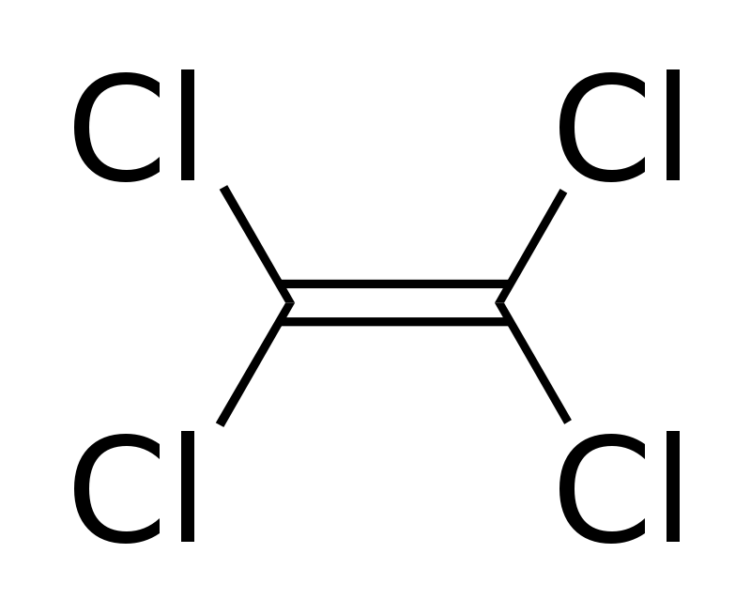
環保署坦言，ＲＣＡ案不僅是外商首例，污染面積也是前所未見，地下水中的四氯乙烯濃度一度超標廿倍；目前整治計畫已展延三次、前後長達十年，但部分監測井中的三氯乙烯濃度仍接近標準值六倍，恐已造成難以回復的傷害。
ASR’s disadvantage
Hard to protection from contaminants
permanent pollution
Tetrachloroethylene

Slide 25
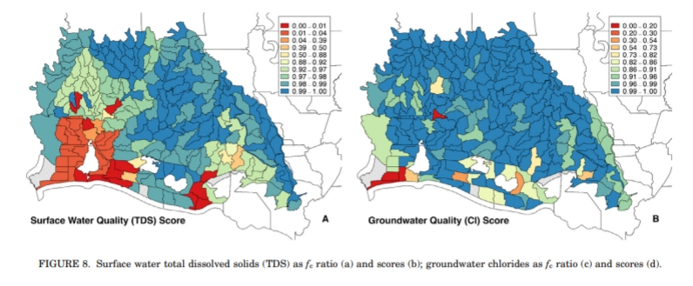
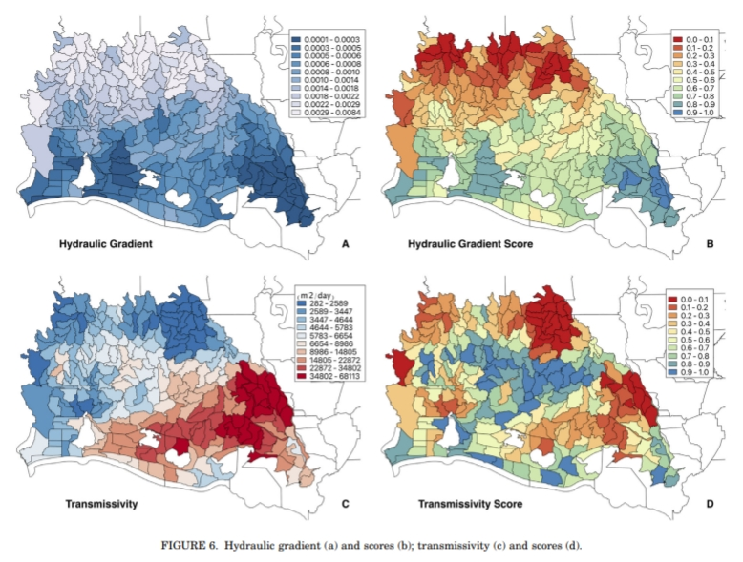
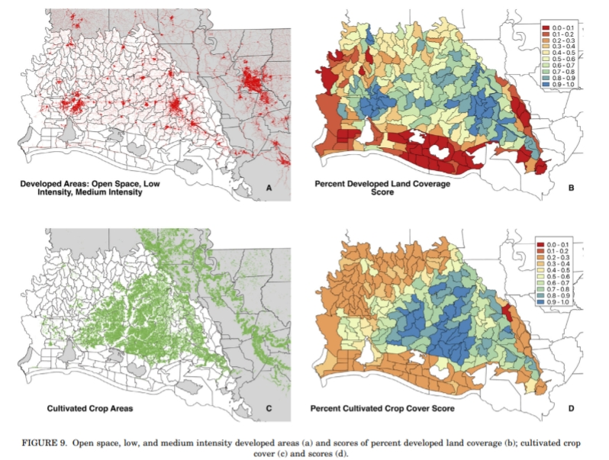
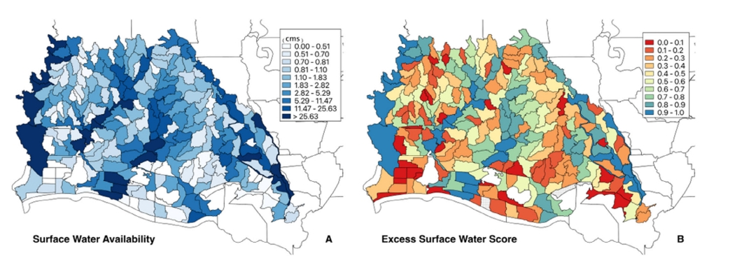
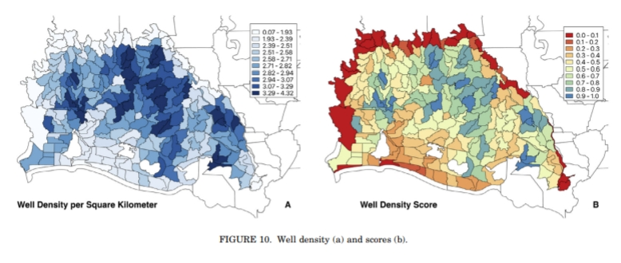
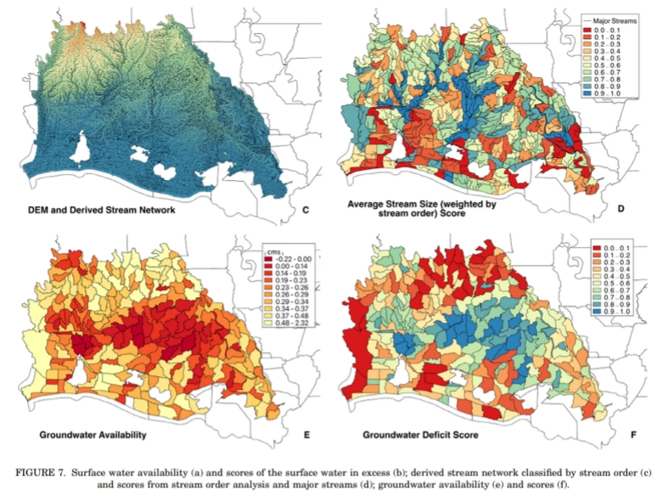
Data processing
Surface water total dissolved solids (TDS) as fc ratio
Storage zone thickness
depth to thickest sand layer
groundwater chlorides as fc ratio
Hydraulic gradient
Open space, low, and medium intensity developed areas
transmissivity
cultivated crop cover
Surface water availability
Well density
derived stream network
classified by stream order
14
groundwater availability

Slide 26
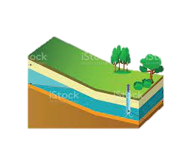
飽和地下水流方程式的推導
Student: Bo-Feng Lee
Advisor: Prof. Jui-Sheng Chen
Co-Advisor: Prof. Ching-Ping Liang
Date: 2022/04/21
A1

Slide 27
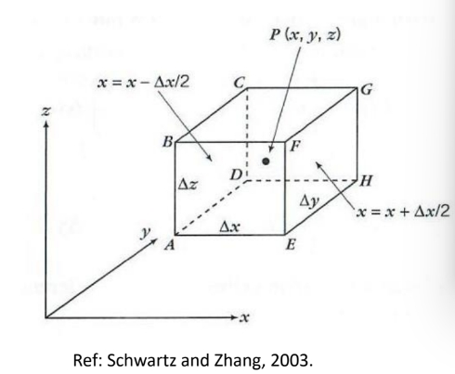
outlines
By mass balance
$$inflow−outflow+generation−comsumption=accumulation$$
p3
p5
p4
A2

Slide 28
v
v
v
v
v
≈0
v
v
v
v
v
≈0
v
v
v
v
v
v
單位體積地下水質量
Ø
Ø
單位體積地下水質量變化率
A3

Slide 29
A4

Slide 30
By mass-balance
the density taken out as a constant
v
v
v
A5

