Slide 1
Impact of large-scale structures on fracture network connectivity: Insights into the Vaca Muerta unconventional play, Neuquén basin, Argentina
國立中央大學
應用地質研究所
National Central University
Graduate Institute of Applied Geology
Correa-Luna, C., Yagupsky, D. L., Likerman, J., & Barcelona, H., 2025. Tectonophysics, 898, 230640.
Presenter : Mu Kuo
Advisor : Wen-Jeng Owen Huang
Date : 2025/05/02

Slide 2
Introduction
Natural fracture networks in rock masses are crucial due to their significant impact on mechanical behavior and fluid flow dynamics.
Understanding fracture networks contributes to managing hydrocarbon production, geothermal energy, groundwater flow and contaminant transport, CO₂ storage, and engineering projects, among others.
Discrete Fracture Network models allow for the assessment of the role of natural fracture networks as pathways for Fluid Flow.

Slide 3
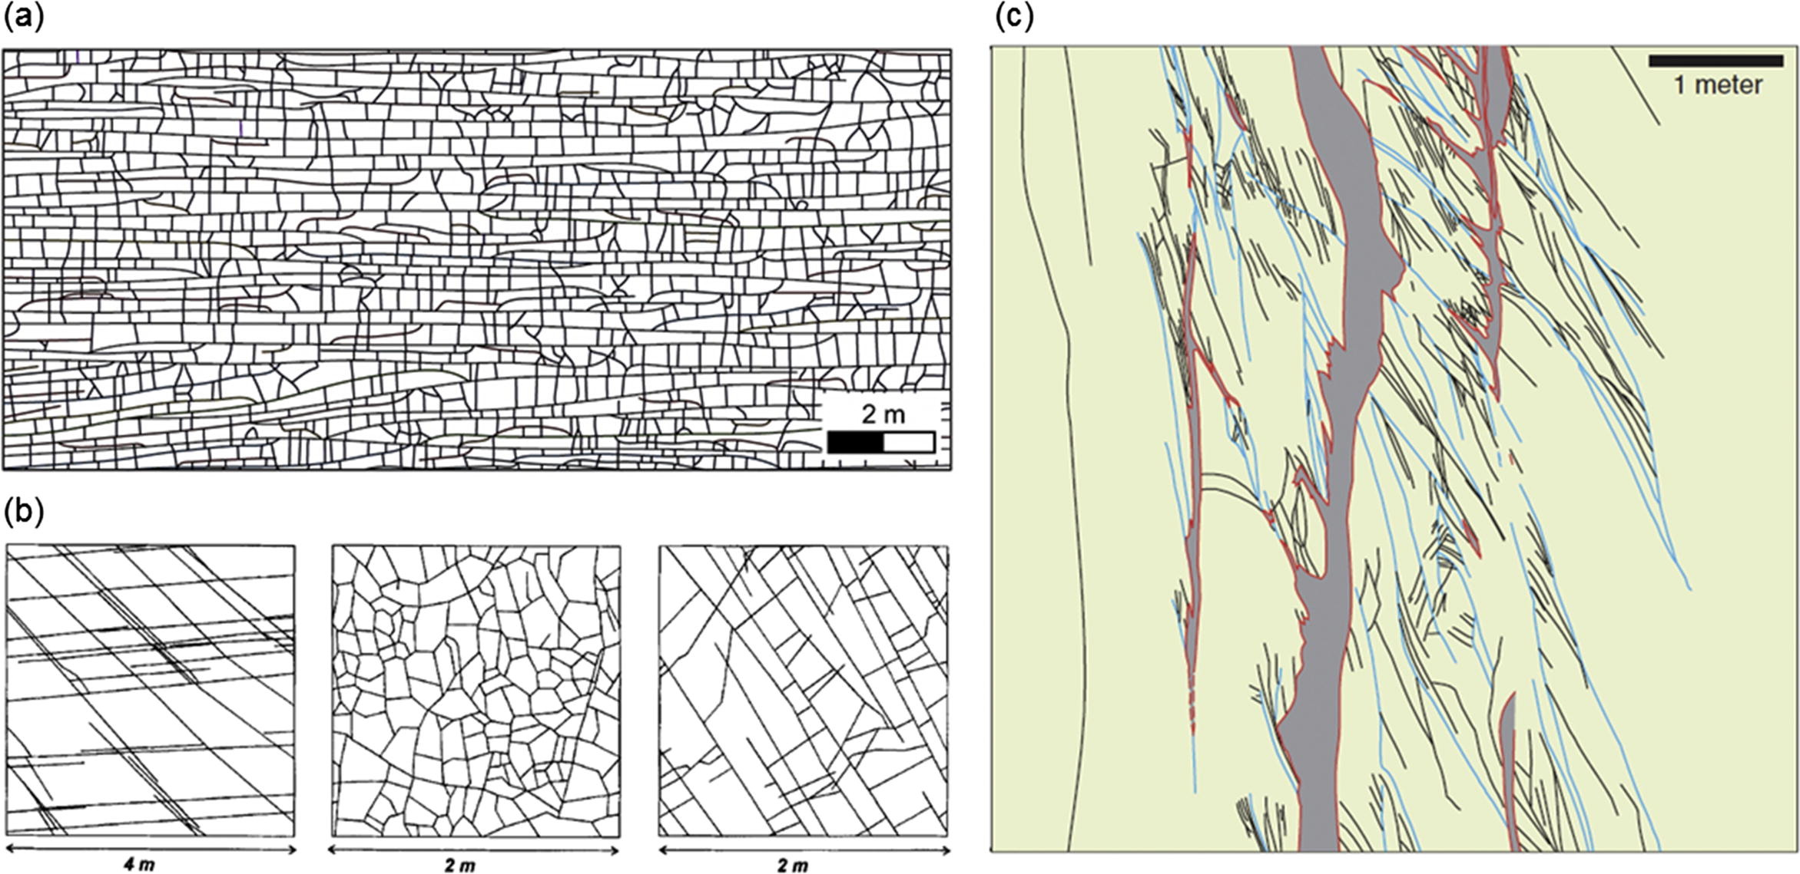
Discrete Fracture Network (DFN)
A model that represents the geometrical properties of each fracture and the topological relationships between individual fractures and fracture sets.
Geologically-mapped DFN patterns. (a) A limestone outcrop at the south margin of the Bristol Channel Basin, UK. (b) Sandstone exposures in the Dounreay area, Scotland. (c) Fault zone structures in the Valley of Fire State Park of southern Nevada, USA. (Lei et al., 2017)
Notes:
DFN model
Provide a robust framework for representing these networks and assessing their role as pathways for fluid migration.
In numerical modeling approaches, it is critical to incorporate the inherent complex discontinuities of rocks to predict their behavior under several external conditions. Discontinuities such as faults, bedding planes, and joints have a strong influence on the mechanical behavior of rocks. Discrete Fracture Network (DFN) models are numerical tools designed to integrate these properties into simulations.
DFN models allow for the assessment of the role of natural fracture networks as pathways for fluid flow.
A “discrete fracture network” (DFN) refers to a computational model that explicitly represents the geometrical properties of each individual fracture (e.g. orientation, size, position, shape and aperture), and the topological relationships between individual fractures and fracture sets. Unlike the conventional definition of DFNs that corresponds to stochastic fracture networks, the term DFN here represents a much broader concept of any explicit fracture network model. A DFN can be generated from geological mapping, stochastic realization or geomechanical simulation to represent different types of rock fractures including joints, faults, veins and bedding planes. (Lei et al., 2016)

Slide 4
Location
Shape & Size
Mechanical & Hydrological Characteristics
Parameters in DFN Model
Orientation
Connectivity
Density
Notes:
1. 裂隙位置（Location）：在三維空間中的具體座標。
2. 裂隙形狀與尺寸（Shape & Size）：裂隙可以是圓形、橢圓形或多邊形，尺寸可能有分布範圍。
3. 裂隙方向（Orientation）：走向（azimuth）與傾角（dip）。
4. 裂隙數量與密度（Density）：如每立方公尺的裂縫長度或面積。
5. 連通性（Connectivity）：裂縫彼此是否交會、交會方式、是否形成可通流的通道。
6. 力學與水力性質（Mechanical & Hydrological characteristics 如滲透率、剪切強度、開度等）。

Slide 5
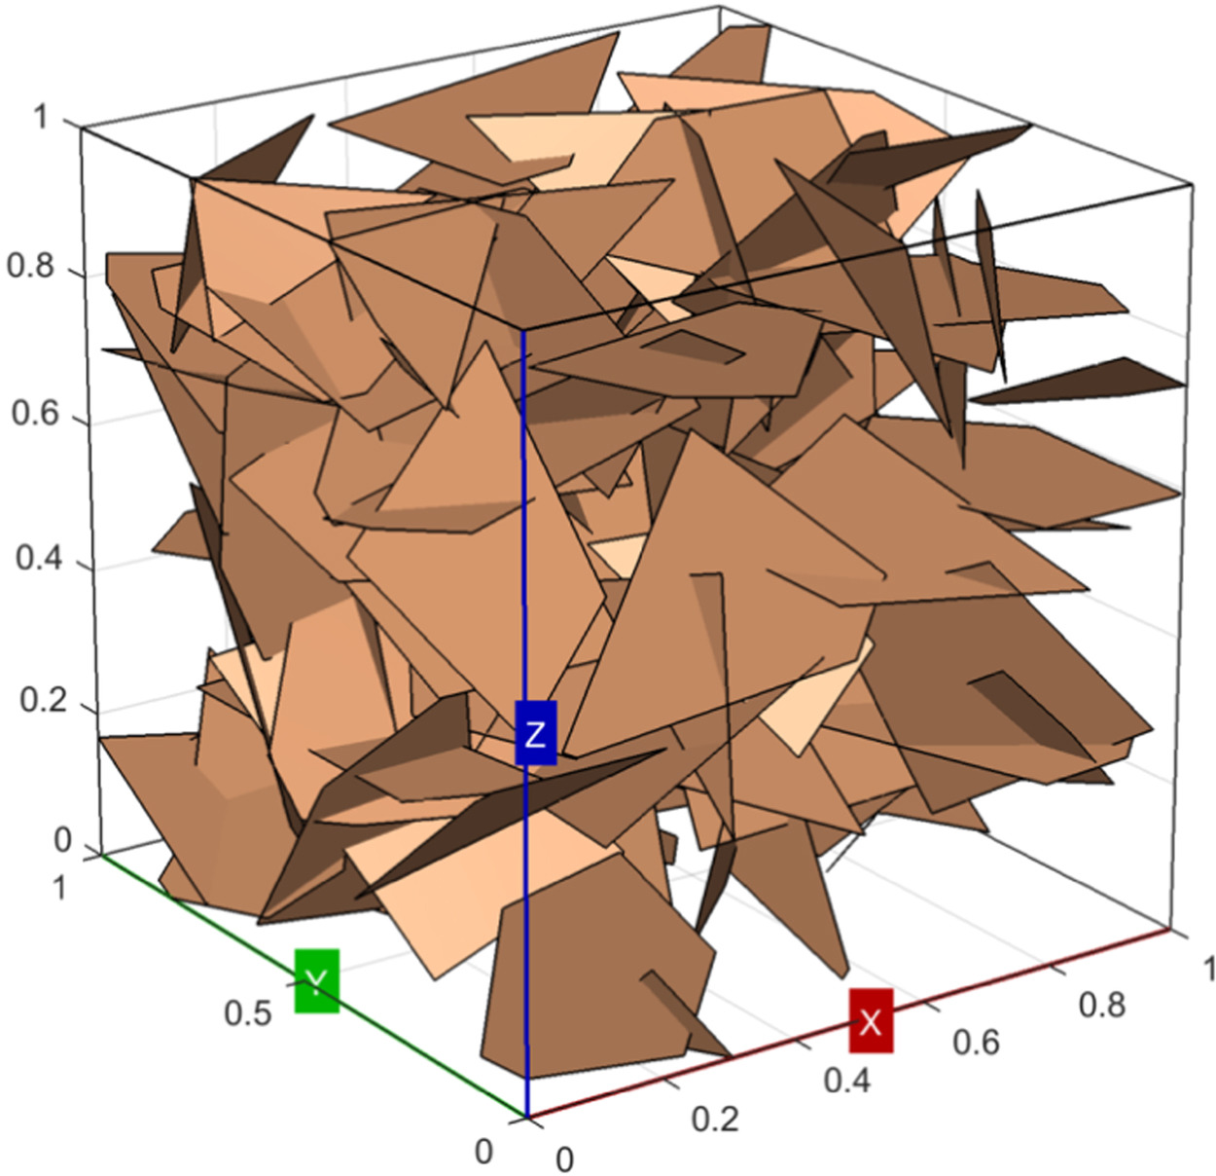
Parameters in DFN Model
Location：3D spatial coordinate
Shape & Size： Fracture can be different Shape and Scale
Orientation： Fracture’s Attitude（Strike & Dip）
Density： Fracture’s Length or Quantity in unit area
Connectivity： Intersection of Fracture
Mechanical & Hydrological characteristics： Permeability, Shear Strength, Aperture size etc.）。
Long et al., (1985)
Alghalandis (2017)

Slide 6
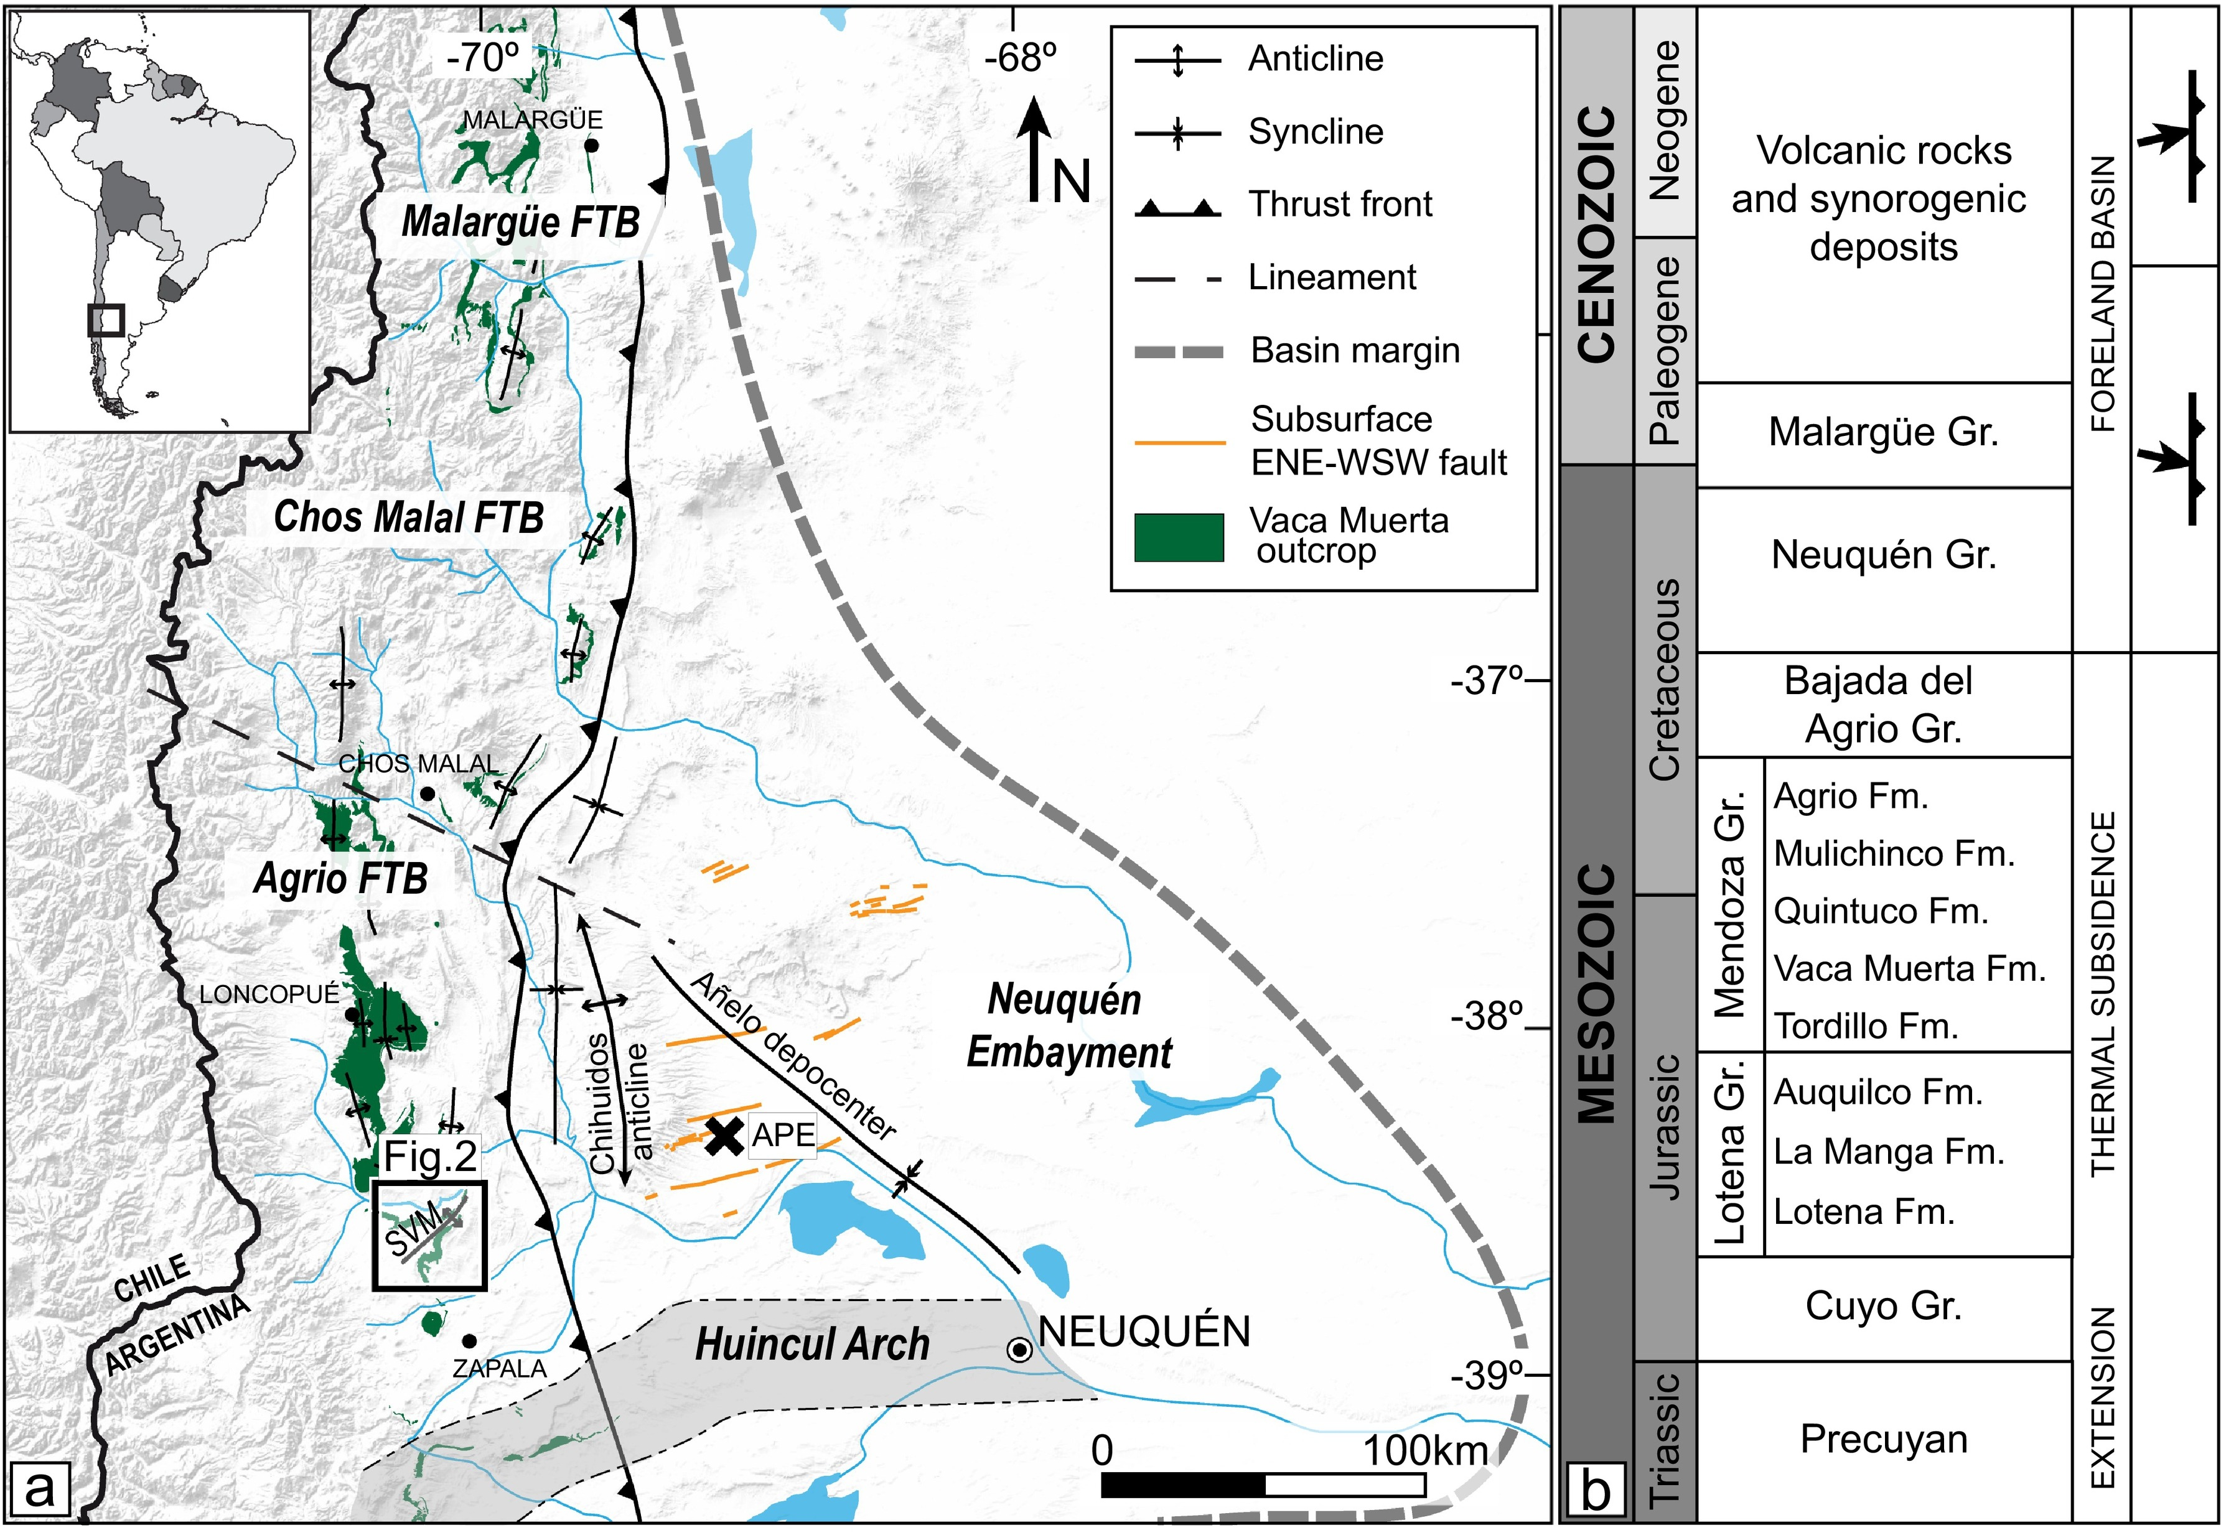
Regional Geology
The main morphostructural units of the Neuquén Basin.
Mesozoic and Cenozoic tectonostratigraphic column and basin stages for the Neuquén Basin, with convergence direction variations from the Late Cretaceous to the Cenozoic.
Notes:
Map shows the main morphostructural units of the Neuquén Basin. The black rectangle shows the location of the study area: Sierra de la Vaca Muerta (SVM). The Aguada Pichana Este (APE) block is marked with a black cross. The subsurface ENE-WSW faults, marked in orange, highlight strike-slip faults at the base of the Vaca Muerta Formation within the Neuquén Embayment area.
Mesozoic and Cenozoic tectonostratigraphic column and basin stages for the Neuquén Basin, with convergence direction variations from the Late Cretaceous to the.

Slide 7
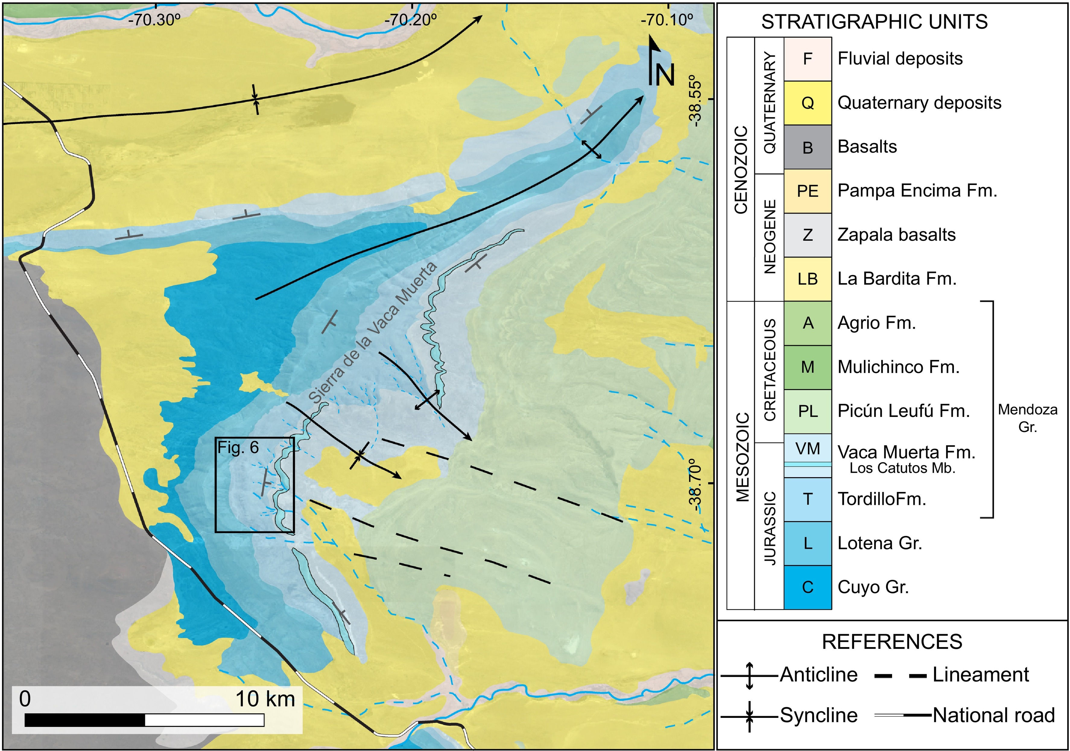
Oil Reservoir
Carbonate & Marl
MDC
In Vaca Muerta, this study investigates how large-scale structures influence fracture network connectivity there.
Notes:
Vaca Muerta層跟Quintuco層是阿根廷內Neuquén盆地的主要生油岩， Vaca Muerta層主要是由石灰岩以及泥灰岩組成。
Lower part of vaca muerta Fm. Is oil reservior. Inside the Fm., There is Los catutos mb. Together with Tordillo Fm., they are where the fracture network been observed.
,

Slide 8
Methodology
1. Data Collection:
Field fracture survey
Georeferenced orthophotos from Unmanned Aerial Vehicle (UAV) aerial photography.
Satellite Photography (Tracing the large-scale fracture)
2. Data processing – Two-dimensional DFN:
ADFNE (Model Building)
FracPaQ (Permeability Anisotropy analysis)
Data Collection
Data processing
Field survey
UAV Photo
ADFNE
FracPaQ
Satellite Photo
Notes:
The study area was selected in the exposed carbonate stratigraphy.
Researchers recorded fracture direction, inclination, spacing, and length in the field.
Generate georeferenced orthophotos from unmanned aerial vehicle (UAV) aerial photography.
Trace the large-scale fracture(e.g. faults) with satellite photography
包含用 include

Slide 9
Methodology
ADFNE
Open source software for discrete fracture network engineering.
Based on the UAV survey area, ensuring inclusion of the large fracture corridors mapped in Tordillo Formation outcrops.
Each fracture set was characterized by mean azimuth, Fisher's k parameter, minimum, maximum, and mean fracture trace lengths, and its length distribution law.
Calculating Intersection Points & the Number of Clusters between fractures.
FracPaQ
FracPaQ is a MATLAB toolbox for the quantification of fracture patterns.
120 simulations were conducted, summarized in cluster mass frequency and proportion histograms, and in the permeability anisotropy results.
Notes:
The study area was selected in the exposed carbonate stratigraphy.
Researchers recorded fracture direction, inclination, spacing, and length in the field.
Generate georeferenced orthophotos from unmanned aerial vehicle (UAV) aerial photography.
Trace the large-scale fracture(e.g. faults) with satellite photography

Slide 10
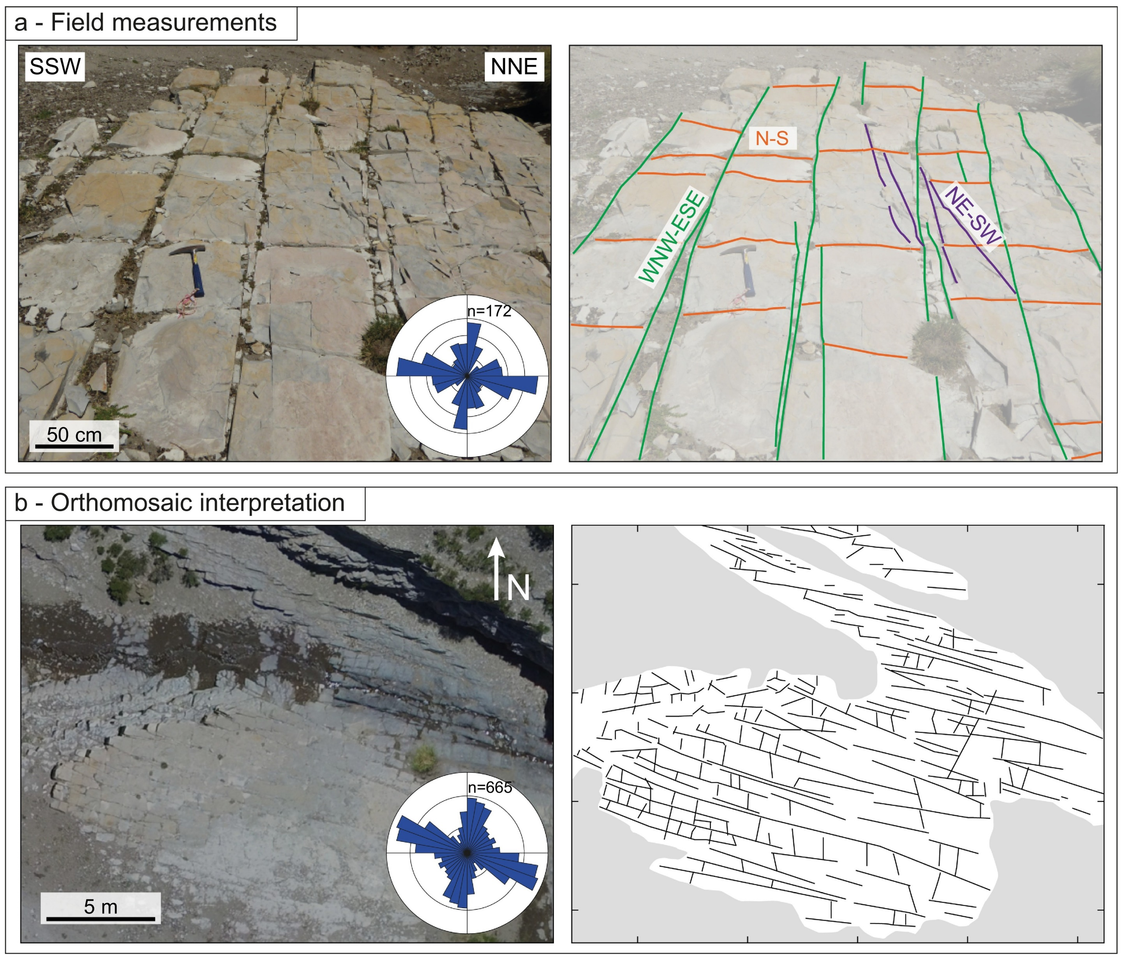
Result
Crack Network of Los Catutos:
The equal-area rose diagram summarizes fracture orientation for each case. Consisting primarily of a set of fractures with a WNW-ESE trend, accompanied by a set of minor orthogonal fractures (N-S trending).
‘ladder-like’ Pattern
The equal-area rose diagram: WNW-ESE trend with a set of N-S trending minor orthogonal fractures.
Field:
Mean spacings: 0.36 - 0.58 m
Traces: 0.22 - 9.92 m
mean trace length = 2.36 m
median = 1.99 m (SD = 1.52 m).
UAV:
Mean spacings: 0.15 - 0.21 m
Traces: 0.2 - 4.57 m
mean trace length = 0.85 m
median = 0.67 m (SD = 0.61 m).
Notes:
Fig. 3.
Field fracture measurements: Outcrop photograph (left) and interpretation (right), highlighting a ladder-pattern between the WNW-ENE and N-S fracture sets.
Orthomosaic (left) and fracture trace interpretation (right) of pavement at Mallín de los Caballos. The equal-area rose diagram (bin width based on the sample size) summarizes fracture orientation for each case. (For interpretation of the references to colour in this figure legend, the reader is referred to the web version of this article.)

Slide 11
Result
Large-scale Fracture:
From the outcrop survey, GPS, and seismic profiles, it was observed that large-scale cracks trended ENE-WSW, had a nearly vertical dip, and ranged in length from a few meters to hundreds of meters.
Isochronous map and minimum curvature (Cmin) of Sequence 11 (Upper Tithonian) on the Aguada Pichana Este block (from Gangui and Grausem, 2014).
Interpretation of ENE-WSW lineaments from this study. Inset equal-area, length-weighted rose diagram of the interpreted lineaments summarizes their orientation.
Notes:
Fig. 5.
Isochronous map and minimum curvature (Cmin) of Sequence 11 (Upper Tithonian) on the Aguada Pichana Este block (from Gangui and Grausem, 2014).
Interpretation of ENE-WSW lineaments from this study. Inset equal-area, length-weighted rose diagram of the interpreted lineaments summarizes their orientation.
NNW-SSE seismic section showing N70° strike-slip faults (from Marchal et al., 2020). (For interpretation of the references to color in this figure legend, the reader is referred to the web version of this article.)

Slide 12
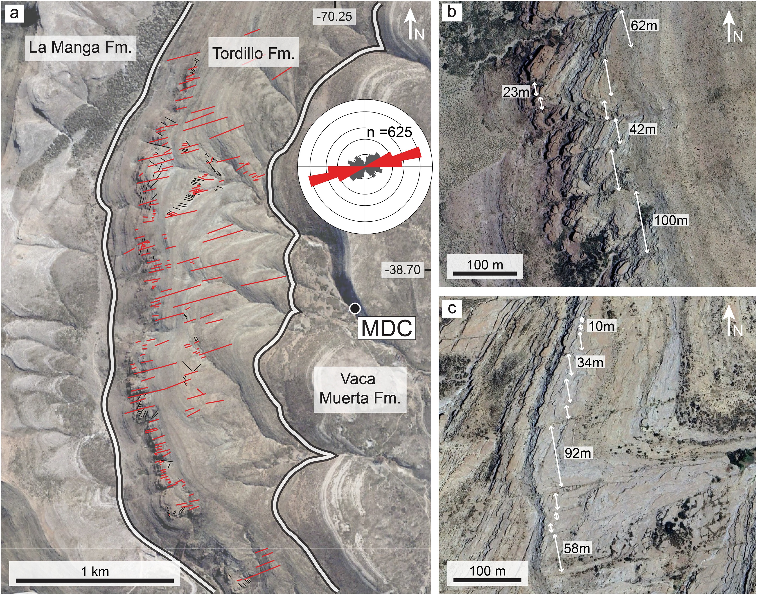
Lineaments interpretation from a satellite image of the Tordillo Formation outcrops. The sampling site, Mallín de los Caballos (MDC).
& (c) Zoom-in of the satellite image highlighting the pattern and spacing of ENE-trending lineaments.
Notes:
Fig. 6.
(a) Lineaments interpretation from a satellite image of the Tordillo Formation outcrops (white lines indicate unit contacts). The sampling site, Mallín de los Caballos (MDC), is shown to the east (see Fig. 2). The inset displays an equal-area, length-weighted rose diagram of lineaments traces. b and c) Zoom-ins of the satellite image highlighting the pattern and spacing of ENE-trending lineaments. (For interpretation of the references to colour in this figure legend, the reader is referred to the web version of this article.)

Slide 13
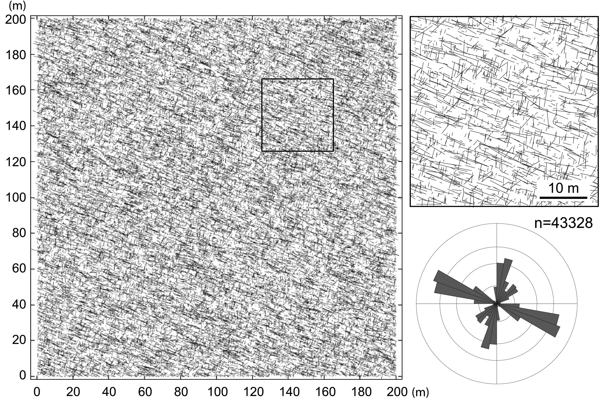
Result
Discrete Fractures Network(DFN):
Results show that the fracture network in the Mallín de los Caballos outcrop is poorly connected. Although clusters show extension in the WNW-ESE direction, they only account for a small part of the network. The overall system is largely segregated, with small clusters and high permeability anisotropy driven by the orientation of fracture clusters and the longest fractures.
Base DFN model (left) and zoom-in (right) with the equal-area, length-weighted rose diagram of the generated synthetic fractures.

Slide 14
Discussion
1. Fracture intersection density: without or with fracture corridors
Without fracture corridors
Fracture corridors increase the average fracture intersection density. The connectivity of the fracture were increased by the large scale ENE-WSW fracture.
With fracture corridors

Slide 15
2. Number of Fracture Clusters: without or with fracture corridors
Without fracture corridors
The figure shows connected fracture clusters colored according to the number of members.
Fracture corridors increase the Number of fracture clusters. That’s another piece of evidence that shows that the fracture corridors increased the connectivity of the fracture.
With fracture corridors
Notes:
Figure shows connected fracture clusters colored according to the number of members.
Fracture corridors significantly increase the fracture network’s connectivity and change the dominant direction of the fracture system.

Slide 16
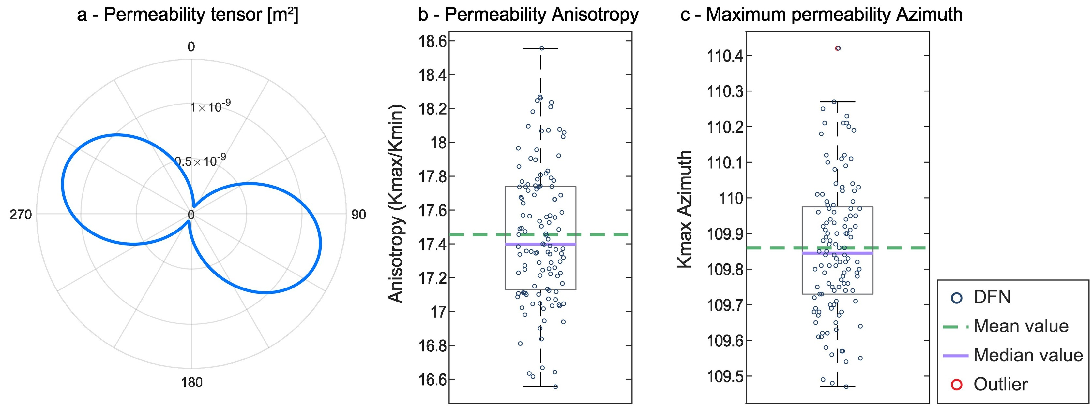
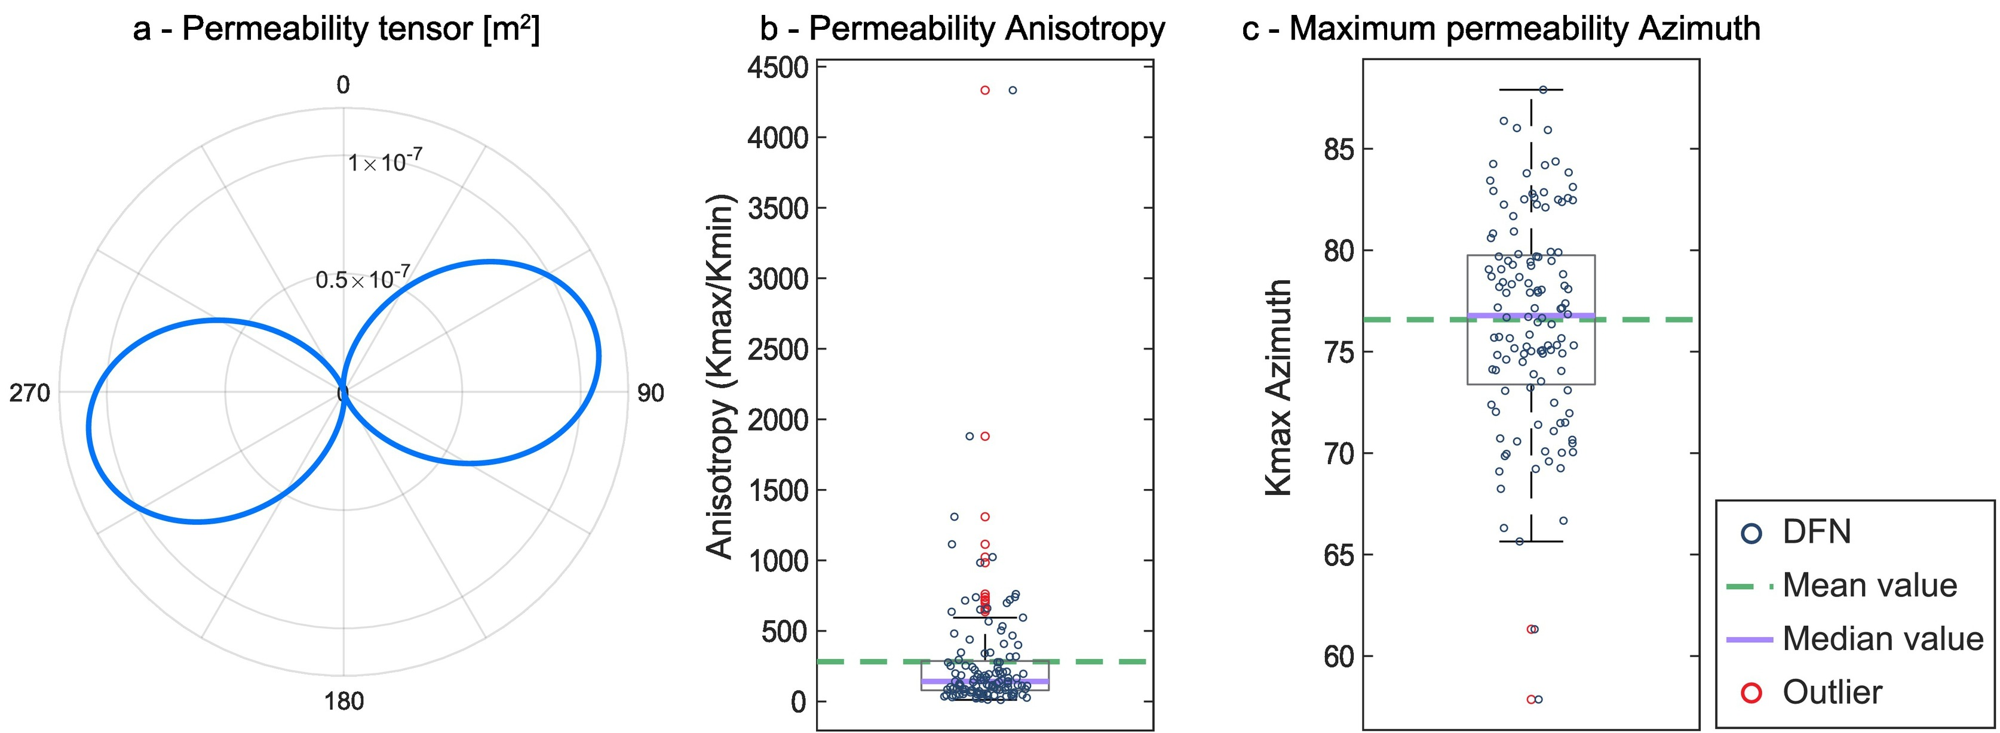
3. Permeability Tensor & Anisotropy
Without Fracture Corridors :
Direction of fluid migration
With ENE-WSW Corridors :
Direction of fluid migration
Changes in permeability anisotropy may affect the hydraulic fracturing process.
Notes:
Fig. 10. DFN permeability:
Permeability tensor of the base DFN model.
Permeability anisotropy (Kmax/Kmin) box plot for all 120 simulations.
Maximum permeability (Kmax) azimuth across all 120 simulations.
Fig. 14. DFN with ENE-WSW corridors permeability.
Permeability tensor of base DFN with corridors model.
Permeability anisotropy (Kmax/Kmin) box plot for all 120 simulations.
Maximum permeability (Kmax) azimuth across all 120 simulations.
Outlier(異常值或稱離群值)可能是由實驗誤差造成

Slide 17
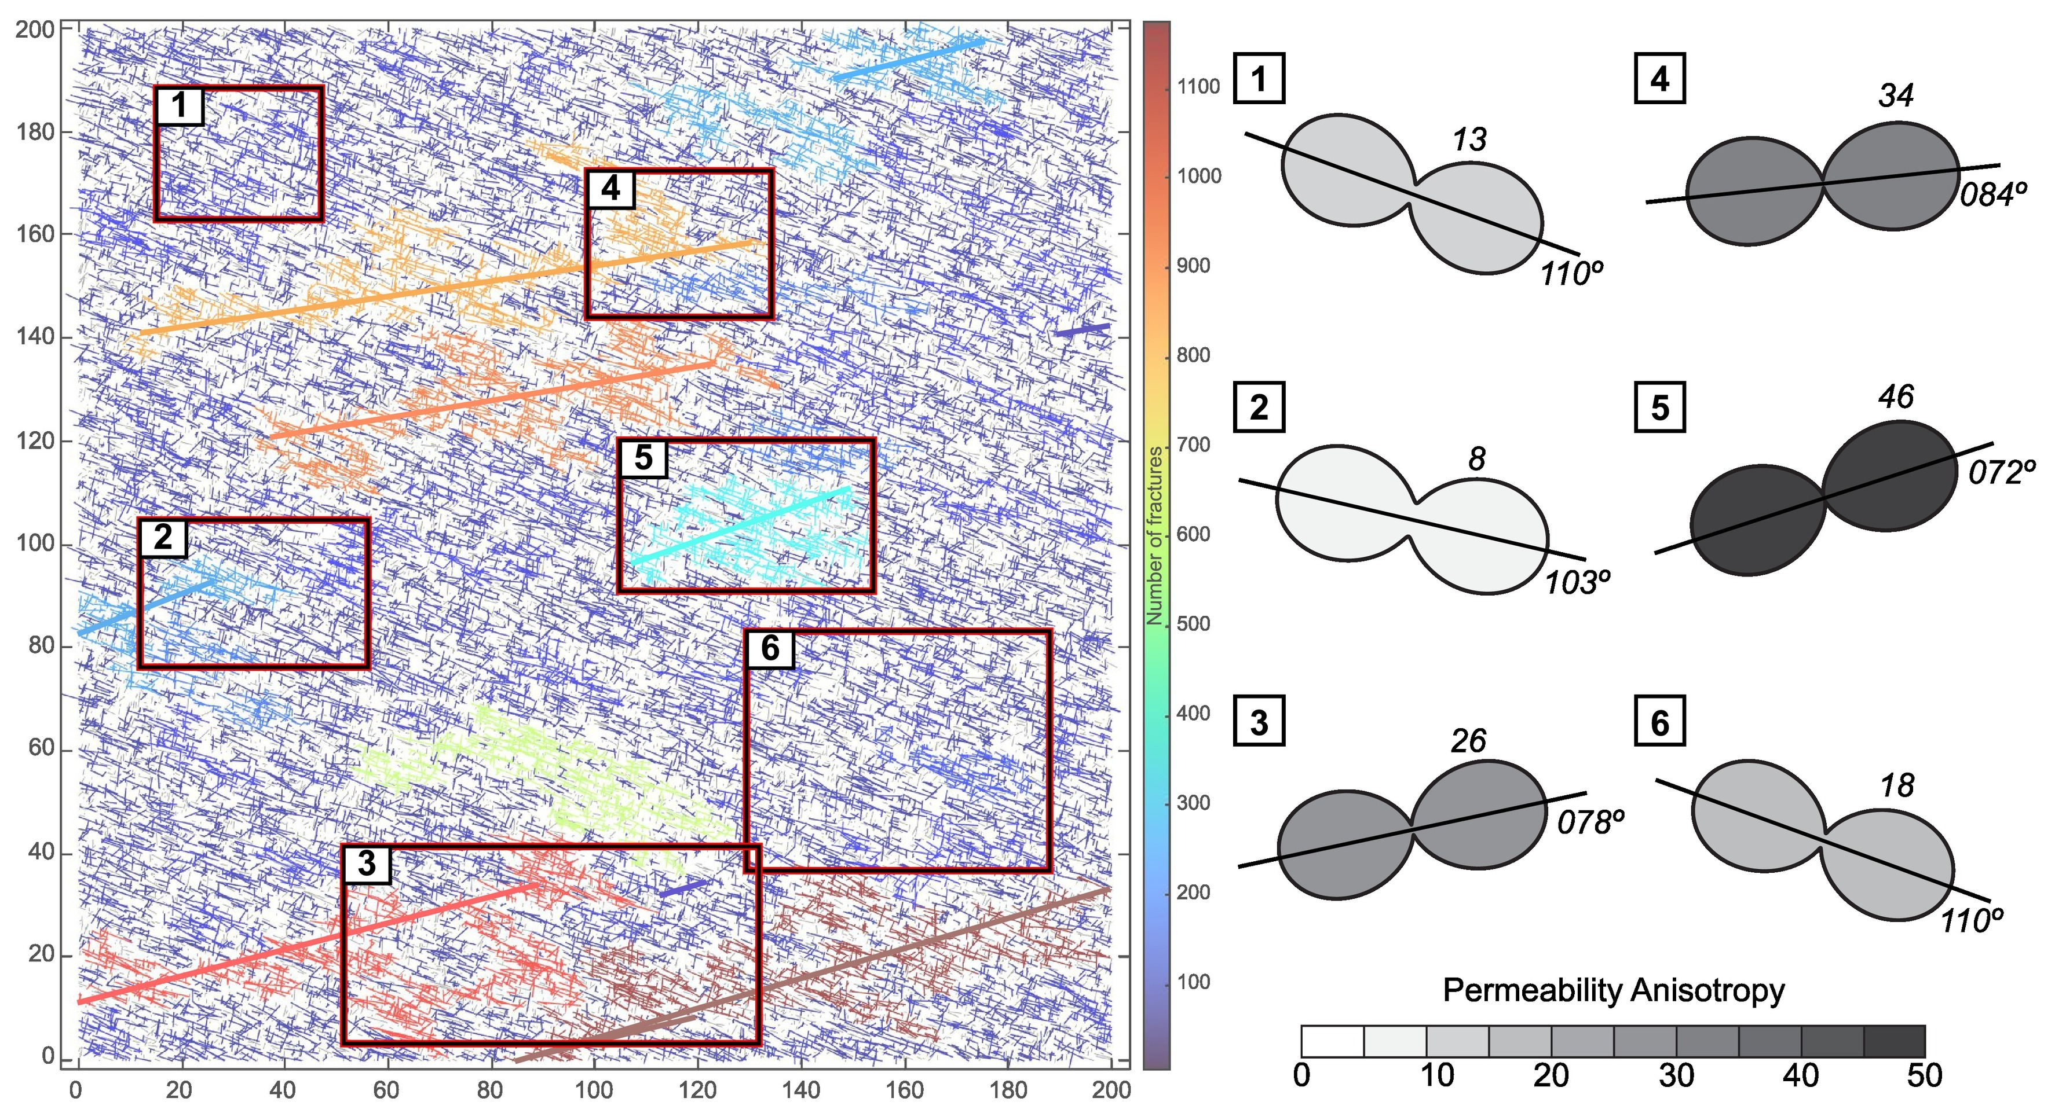
4. Base DFN with corridors cluster map and 2D permeability tensors for six selected sampling sites.
The right panel shows the permeability tensors for each sampling area, with anisotropy (Kmax/Kmin) values, and the orientation of the tensor's long axes indicating the direction of maximum permeability. These structures may serve as major pathways for fluid migration, affecting the reservoir’s productivity.
Notes:
Fig. 15. Base DFN with corridors cluster map (Fig. 9b) and 2D permeability tensors for six selected sampling sites. The right panel shows the permeability tensors for each sampling area, with anisotropy (Kmax/Kmin) values, and the orientation of the tensor's long axes indicating the direction of maximum permeability.

Slide 18
Conclusion
A discrete fracture network (DFN) model is developed using a multi-scale approach that combines field data, UAV-derived orthomosaics, and satellite imagery.
ENE-oriented large-scale structures observed near this site within the Tordillo Formation outcrops were characterized and interpreted as fracture corridors.
In the absence of large-scale structures, the fracture network connectivity of the Vaca Muerta reservoir is low, and fluid flow is restricted.
Fracture corridors significantly improve the connectivity of the fracture network, increase permeability, and change the direction of fluid migration(anisotropy), which is crucial to the development of shale oil reservoirs.

Slide 19
Thank you for your attention.

